Slide 1
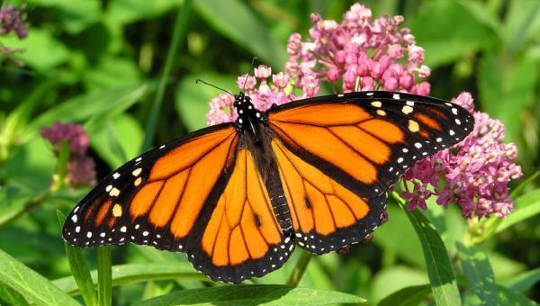
Animals & Their Habitats

Slide 2
tundra
cold for a very long time
almost no animals live here
mostly small bushes and plants
Notes:
The tundra biome is the driest place on Earth.
During the summer, the tundra experiences 24 hour days, can you imagine it being sunny the entire day and night?

Slide 3
Desert
extreme temperatures
hot during the day and cold at night
little plants and animals
mostly sand and rock

Slide 4
Rainforest
many different plants and animals
rains most of the year
Notes:
In the moist rainforests of South America, sloths move so slowly that algae are able to grow in their fur.

Slide 5
Grassland
little variation of plants
grasses
large amount of land

Slide 6
Savannah
many animals
temperatures change
part desert part grassland
Notes:
Ask the students if they have ever seen the Lion King, and explain to them that the setting is a savannah

Slide 7
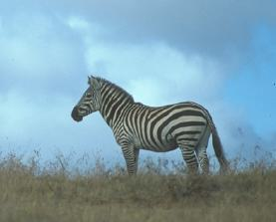
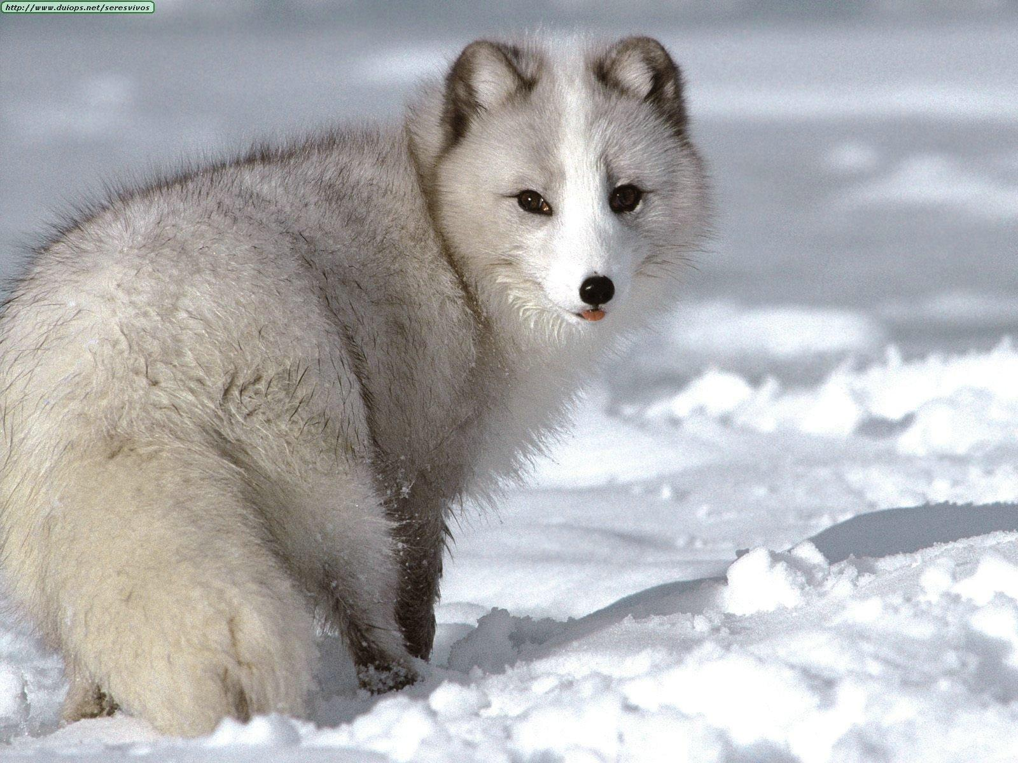
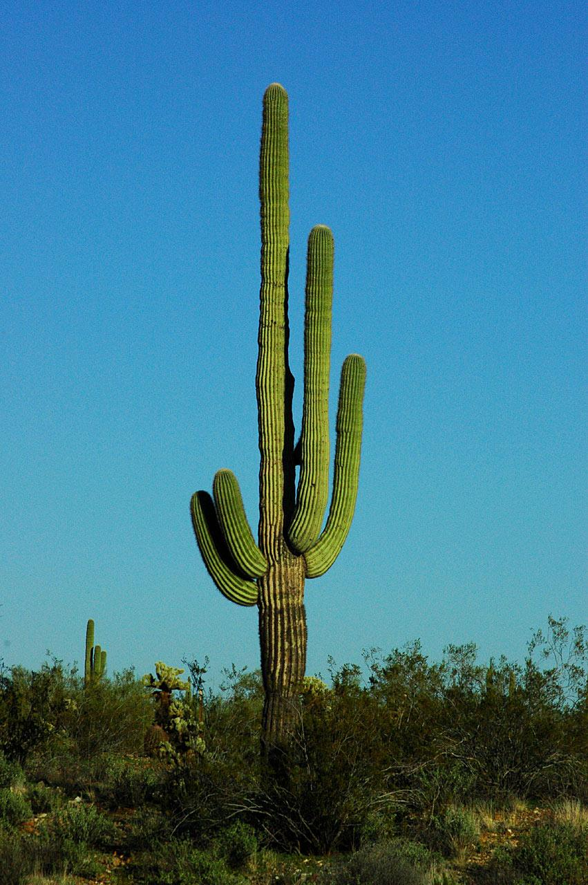
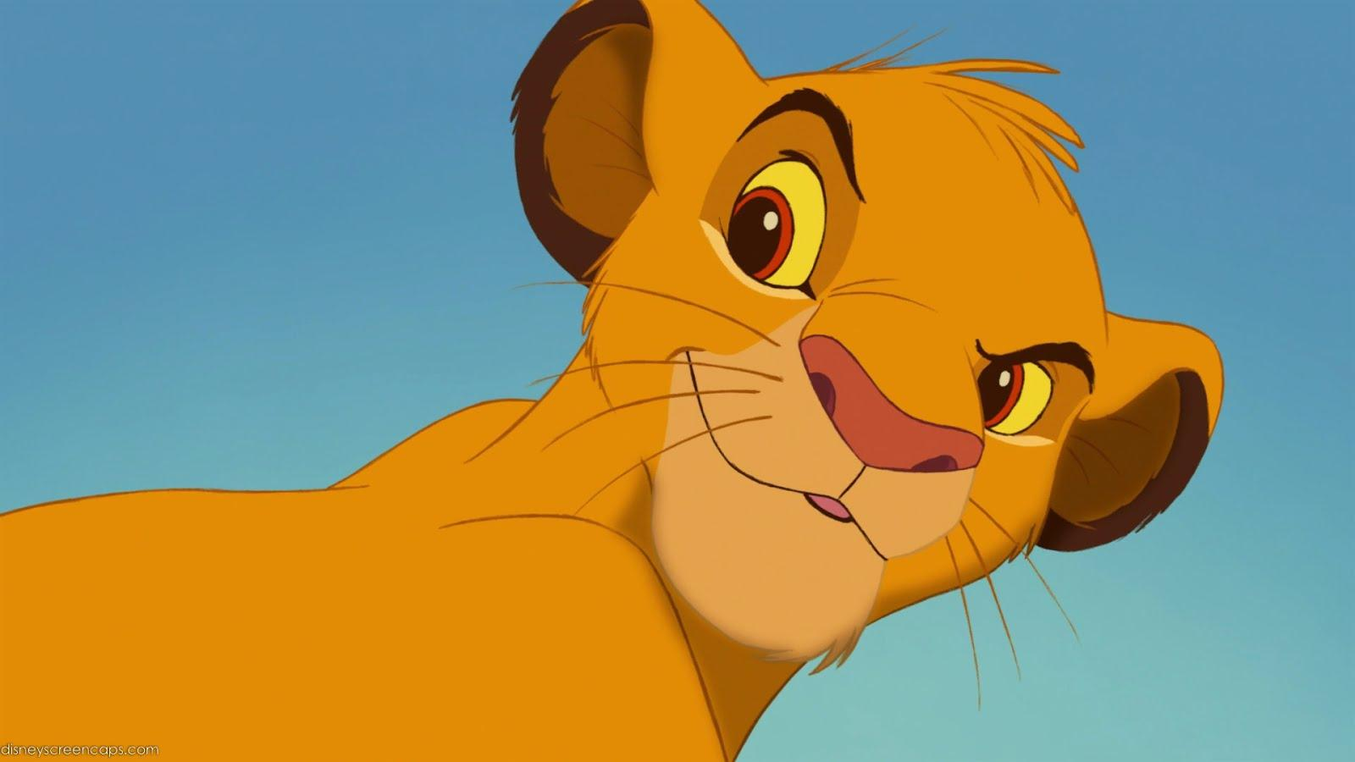
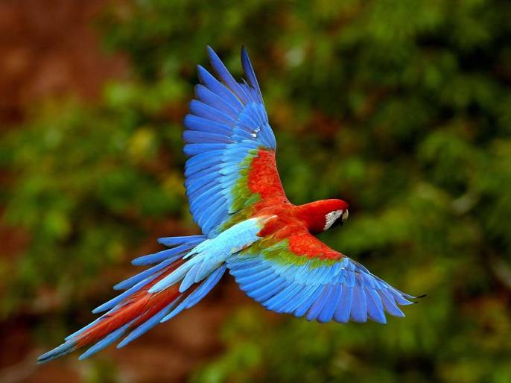
where do these things live? EXTRA CREDIT!!!
#4
#1
#3
#2
#5
Notes:
Ask the students where each animal/plant lives and once they say the correct ecosystem, click on the slide and the name will show up underneath the picture.

