Slide 1
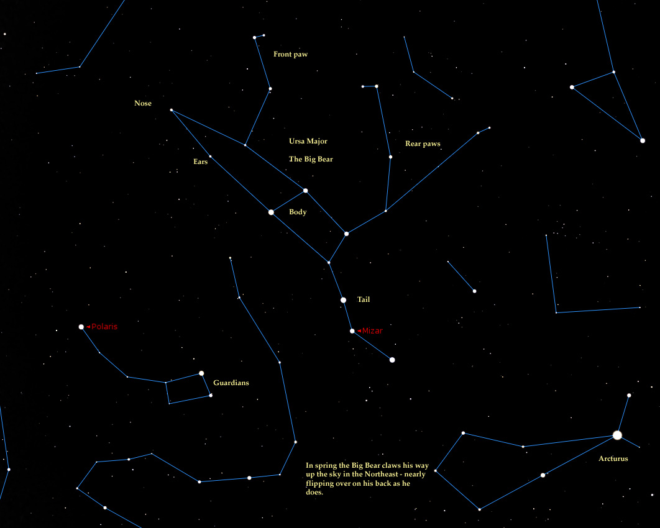
Constellations
Notes:
Week 5

Slide 2
Constellation - Patterns formed by stars in the night sky
Many of them are named after characters in mythology
Notes:
Let them copy down definition and take notes.

Slide 3
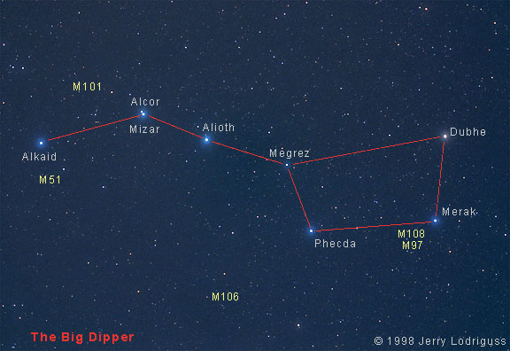
Big Dipper
Made up of 7 stars
Makes up the tail of Ursa Major
Notes:
Its the tail of Ursa Major! Its the most popular and points to Polaris

Slide 4
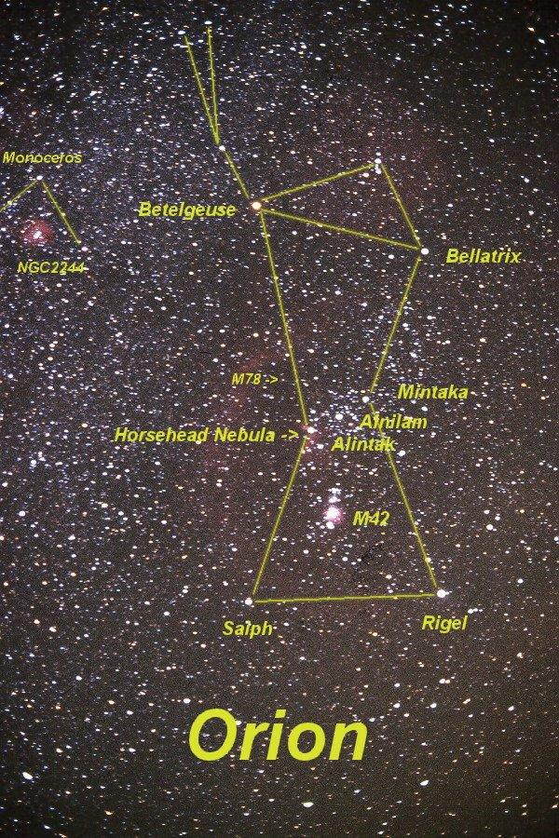
Orion
Clearly visible from Nov to Feb
All but one star are blue giants
Notes:
Orion got stung by a scorpion in the heel- Fun Fact. Fights Scorpio- the constellation next to him.

Slide 5
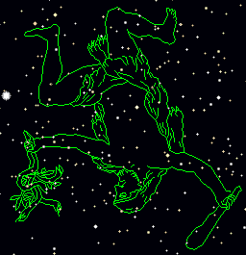
Hercules
-Named after the legendary Greek hero.
-First discovered by Ptolemy in the 2nd century.
-Hercules was the biggest and strongest of all the Greeks.
Notes:
Hercules was the champion of Greece who killed Leo the Lion

Slide 6
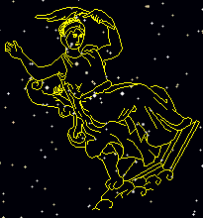
Cassiopeia
-Constellation in the northern hemisphere also charted by Ptolemy.
-Legend has it, she became a constellation as a punishment for her vanity.
Notes:
This is a constellation and legend has it that Casseoepia was punished for her vanity

Slide 7
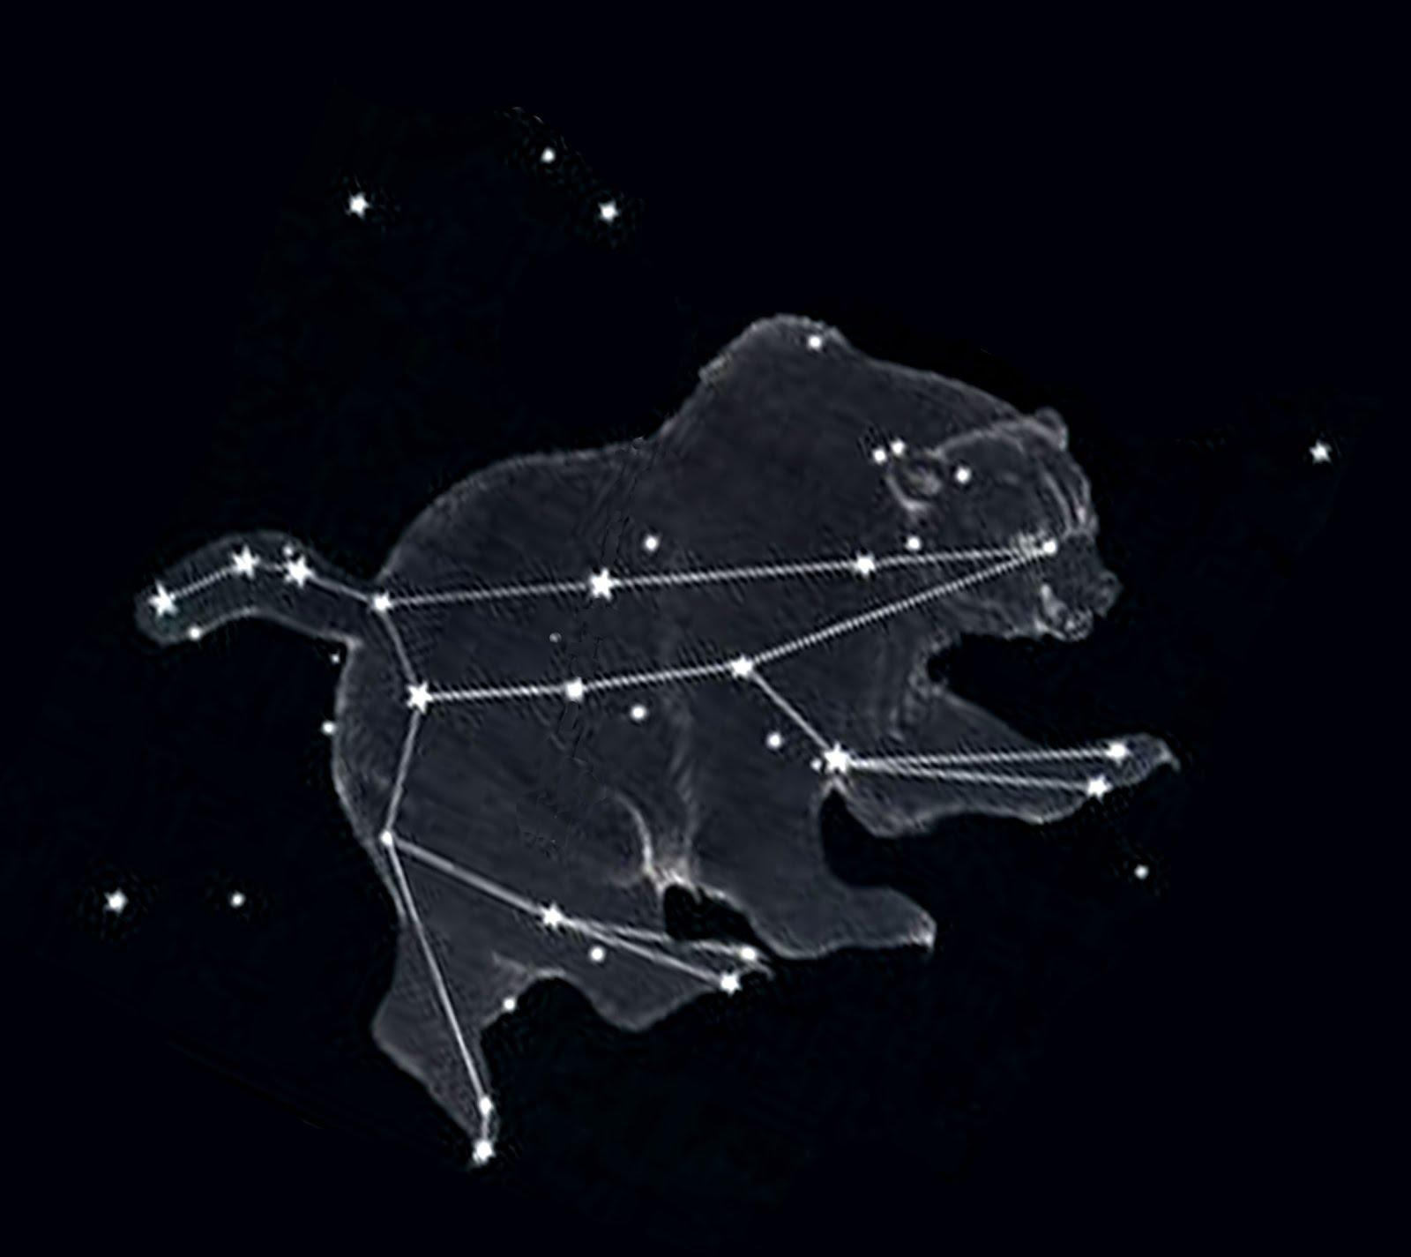
Ursa Major
Latin for Big Bear
Seen throughout most of the northern hemisphere
Important part of many cultures
Notes:
Ursa Major is a constellation and in latin means Big Bear

