Slide 1
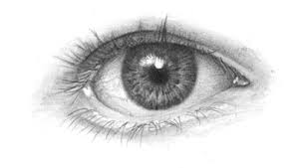
Sight
How the Human Eye Sees

Slide 2
What you’ll learn
How light reflecting from objects & entering the eye allows objects to be seen
How different parts of the eye work together to deliver an image to the brain

Slide 3
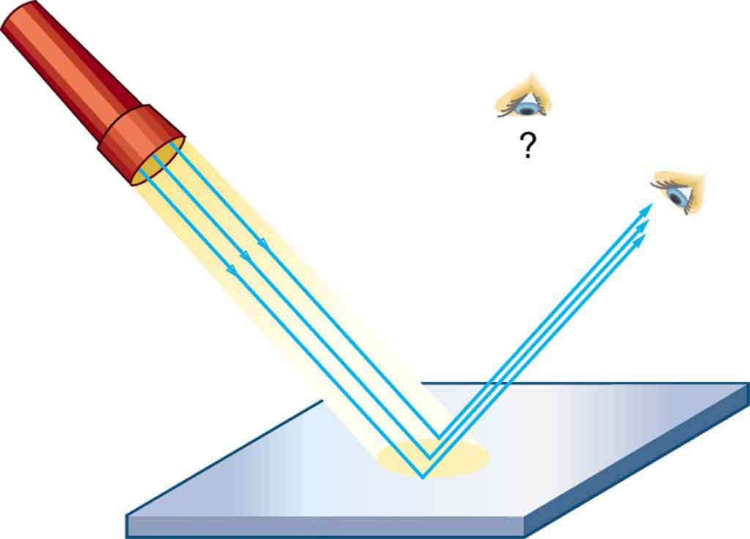
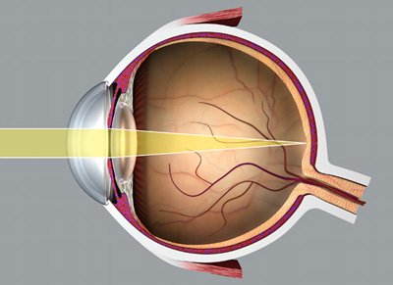
You Can’t See Without Light!!
There must be light in order to see
The light reflects off objects
If one is looking at the object, the reflected light enters the eye
No Light = No Vision
Notes:
- Our eyes are sensitive to a narrow band of light frequencies
- Visible light consists of wavelengths ranging from 780 nanometers to 390 nanometers
- Long wavelength corresponds to red light
- Short wavelength corresponds to blue light

Slide 4
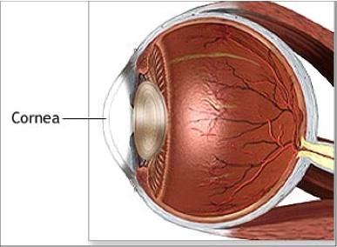
Protection and Focus
A thin layer of tears covers and protects the front layer of the eye called the cornea
The cornea is a clear front cover that focuses the light entering the eye
Notes:
- The eyelids help protect and lubricate the eyes by spreading the tears around
- Eyelids contain no subcutaneous fat and are supported by a tarsal plate
- Under the tarsal plates are glands that emit oil to keep the tears from evaporating too quickly
- There is also more moisture on the other side of the cornea called the aqueous humor, which circulates and keeps a constant pressure on the eye

Slide 5
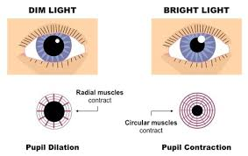
The Center
The pupil is the circular black circle in the center of the colored part of the eye
Bright lights decrease the size of the pupil
Dim lights increase the size of the pupil
Notes:
- The iris regulates the amount of light entering the eye by controlling the size of the pupil
- The pupils may also dilate if one sees an object of interest
- Some animals may have non circular pupils

Slide 6
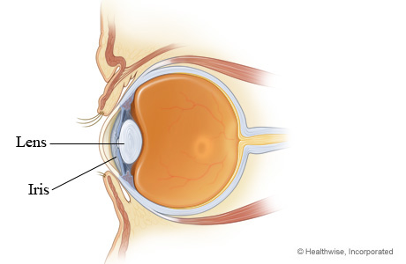
The Lens
The Lens is located behind the pupil
It focuses the image by allowing the light to strike the retina correctly
AKA refraction
Notes:
- When the lens focuses the light, the image is turned upside down
- Our nerves from the eyes send the upside down picture to the brain and the brain flips the image up

Slide 7
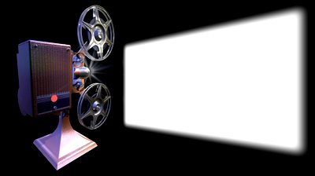
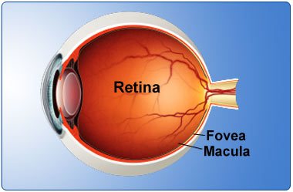
Into the Eye
The retina is the light’s final destination
The retina acts as a movie screen, absorbing the focused light into its photo receptors
The retina has many working parts
Notes:
- There are two types of photoreceptors: rods and cones
- The retinal pigment epithelium are important cells under the photoreceptors that abosorb excess light so the photoreceptors can give a clear signal
- Cones are the color sensing cells
- Rods cannot distinguish between lights of different wavelengths
- Other colors include yellow, green, and purple lights

Slide 8
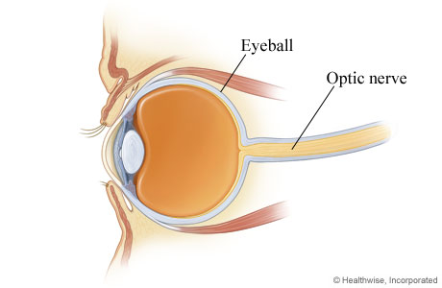
Seen in Your Head
The photoreceptor’s signals are sent to the optic nerve located in the back of the eye
The optic nerve then sends these signals to the visual center in the brain
Notes:
- The beginning of the optic nerve is called the optic nerve head or optice disc
- There are no photoreceptors in the optic nerve head and this area cannot respond to light
- This results in a blind spot
- Everyone has a blind spot in each eye

Slide 9
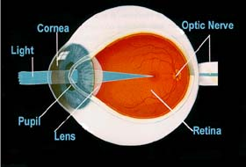
Recap
Light reflects off object into eye
The cornea focuses the light
The Lens bends the light to strike the retina correctly
Retina is the light’s final destination
Optic nerve sends image to brain

