Slide 1
FOSSILS

Slide 2
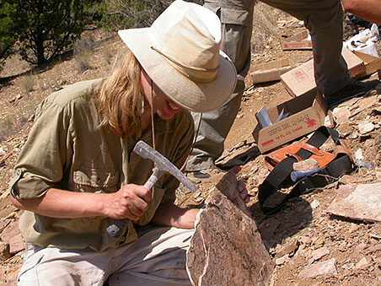
Who studies fossils?
Paleontologists
Paleontology: study of fossils
Notes:
Give basic info such as the name of the researchers who study fossils. Explain what paleontologist and any misconceptions. Give a little background about paleontologists. Then proceed with the definition of paleontology.

Slide 3
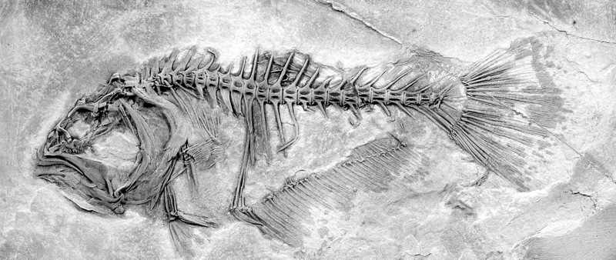
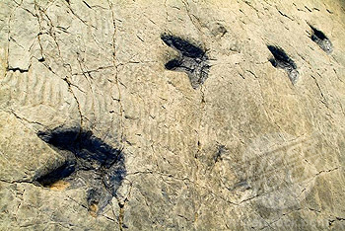
Fossils:
a) body fossils: remains of an animal ex: bones
b) trace fossils: remains of activities ex: footprints, shells, nests
Notes:
Lesson 3. Go in dept of what types of fossils there are. Interact with the students by asking them for examples for each type of fossils
Teacher’s note: In the beginning of the lesson, ask students if they know what a fossil is. Explain that there are two types of fossils and give an example of each type of fossils.

Slide 4
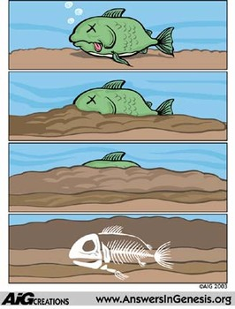
How are fossils formed?
1. Fossils start forming when a living thing or its traces are buried by mud, dirt, or ash.
2. Soft parts rot away, and only hard parts remain/are preserved.
Notes:
Teacher’s note: start out with question- does anyone know how fossils are formed?
Then go into depth on how fossils are formed and what happens to the body parts and structure as time progresses. Make sure to clarify that the bones are undamaged only if the animal is buried with its flesh and bones altogether. Then the soft parts begins to disintegrate.

Slide 5
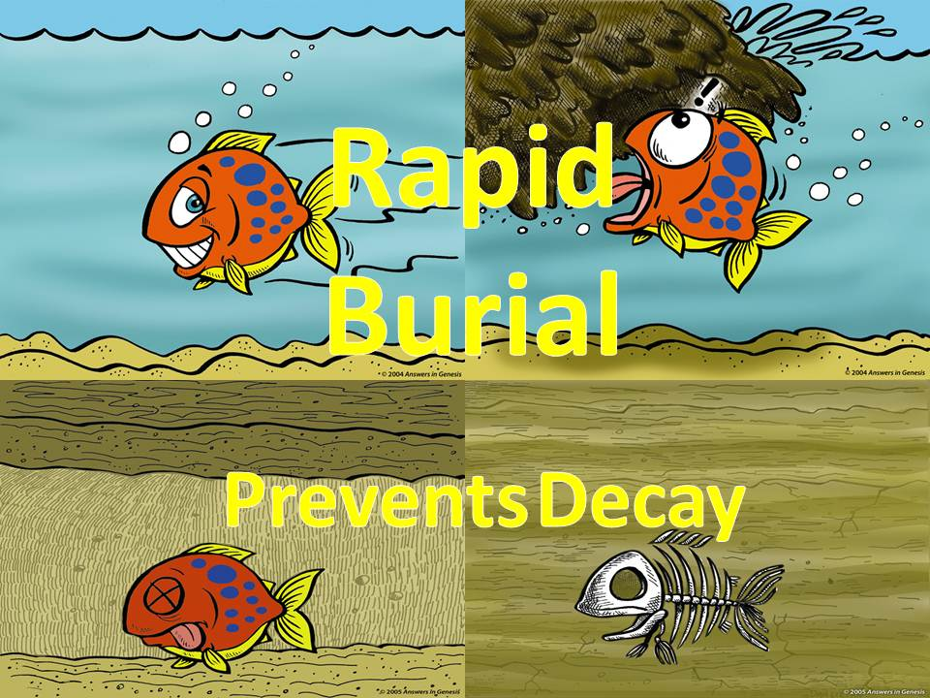
animals that die near lakes, oceans, or rivers will fossilize faster
heavy layers of soil --> sedimentary layers
the quicker the animal is buried the better condition the bones will be.
Notes:
Teacher’s note: start out by stating three main processes a fossil must undergo in order to be fully fossilized, unharmed. Use the picture as a reference.

Slide 6
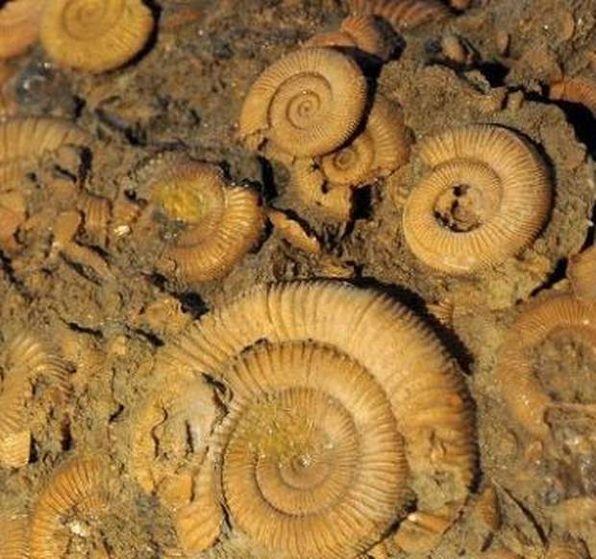
Why are fossils important?
Tell us about the oldest animals that lived on Earth (3.8 billion years ago).
Show how animals used to look like/act.
Time periods of each animal and its activities
Notes:
Teacher’s notes: explain why fossils are important and how they are also able to provide information on organisms 3.8 billion years ago. For the second bullet, provide examples (dinosaurs) on how fossils help scientists infer features of dead animals. The fossils also help the scientists understand how animals acted, what type of food they ate and where they lived.
Explain the picture: These fossils were recently found in Australia. They were dated to be around 3.5 billion years ago. “If we were to go back in Australia and went to the beach we would see slimy mass of purple or brown fibres emitting this stench of sulphur compounds (insert fun question-how many of you know what rotten eggs smell like?) but living very happily”.
Then conclude with: fossils help us realize what happened years before, what kind of animals lived before humans did, and what caused the decease of so many creatures. Then go more in-depth with mass extinctions.

Slide 7
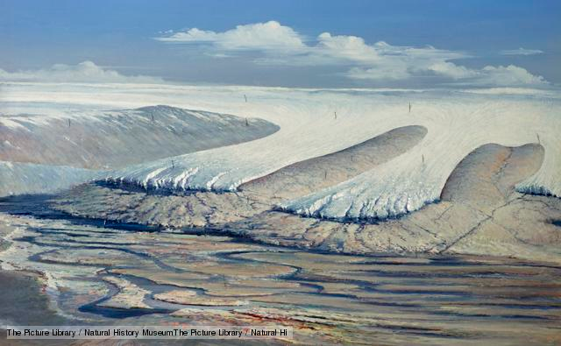
First Mass Extinction
Ordovician-Silurian mass extinction
443 Million years ago
3rd largest extinction
mostly sea creatures
caused by climate
changes
Notes:
Teacher’s note: Focus on the fact that this extinction targeted mainly the sea creatures. Explain how the consequences of climate change can lead to such drastic measures. Main reason for climate change- the ice age. The ice sheet in the southern hemisphere caused climate change and fall in the sea level. This change caused a disordered society amongst the animals.

Slide 8
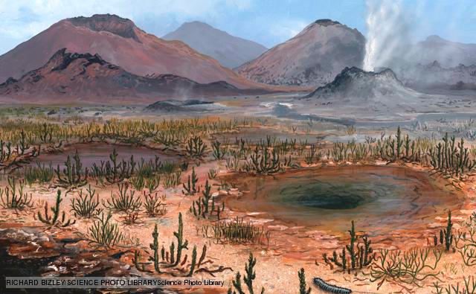
Second Mass Extinction
Late Devonian mass extinction
359 million years ago
¾ of the species died
caused by changes in sea levels, asteroid impacts, climate change
affected mostly animals that lived in shallow seas
Notes:
Teacher’s note: Explain why this extinction affected mostly animals that lived in shallow seas. With the asteroid impacts and other climate changes, sea levels had less oxygen. Little to no oxygen make it hard for organisms to live. New soil -> hard for organisms to survive and adapt.

Slide 9
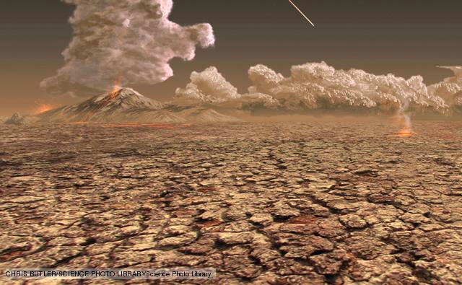
Third Mass Extinction
Permian mass extinction
248 million years ago
“the Great Dying”
caused by an asteroid, flood eruptions, drop in oxygen, gas release, and decreased sea levels
marine creatures were greatly affected & insects faced the only mass extinction.
Notes:
Teachers note: Explain why this mass extinction in particular is called “Great Dying”. It’s called “Great Dying” because staggering 96% of species died out. All life on Earth today is descended from the 4% of species that survived.
A drop in oxygen levels and a decrease in sea levels caused many marine creatures to die. Once an important animal dies, it affects the whole food chain and other ecosystems and populations as well. Since many organisms depend on oxygen as well, the insects were also affected as they faced their mass extinction.

Slide 10
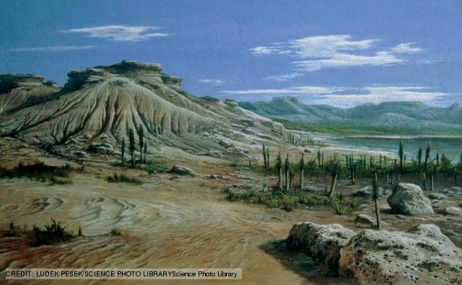
Fourth Mass Extinction
Triassic-Jurassic mass extinction
200 Million years ago
caused by climate change, flood eruptions, and asteroids
many marine creatures died
Notes:
Teacher’s note: This extinction period mainly affected marine reptiles, large amphibians, reef-building creatures and molluscs are examples of aquatic organisms that were heavily affected. State that although, roughly half of all the animals or organisms that were alive eventually died, plants were hardly affected.

Slide 11
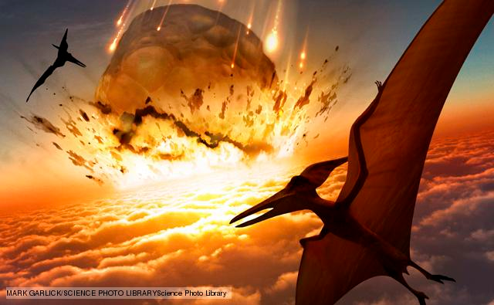
Fifth Mass Extinction
Cretaceous-Tertiary mass extinction
65 million years ago
famous for the death of dinosaurs
caused by flood eruptions --> hardly any more water
also caused by a meteorite
Notes:
Teacher’s note: To make the lesson engaging, ask students if they know what dinosaurs are. If yes, ask what do they think about dinosaurs? Then continue teaching about this extinction periods and how it was known for the disappearance of dinosaurs. Because of an meteorite (explain what it is if the students do not know), our beloved dinosaurs are gone.

Slide 12
Possible Sixth Mass Extinction?
plants, animals are dying off
not caused by natural disasters
.... but caused by what or who?
Notes:
Teacher’s note: Ask students if they know what there may be a possible 6th extinction after learning about the past. Have them guess who is the main cause. Then explain how human beings are the cause of depletion of animals due to the new industries and pollution that we create. Compare to the past extinctions. What’s different?

Slide 13
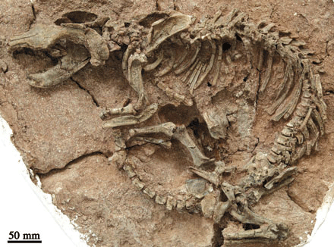
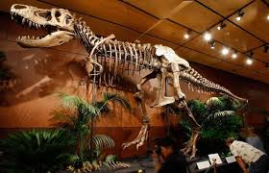
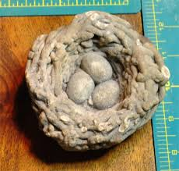
Why are fossils so important?
Notes:
Teacher’s note: Ask students why they think fossils are important? How much can you learn just by studying fossils? How are they made? Why do researchers try so hard to recover these bones? Recap on why fossils are important.

