Slide 1
Weather & Climate

Slide 2
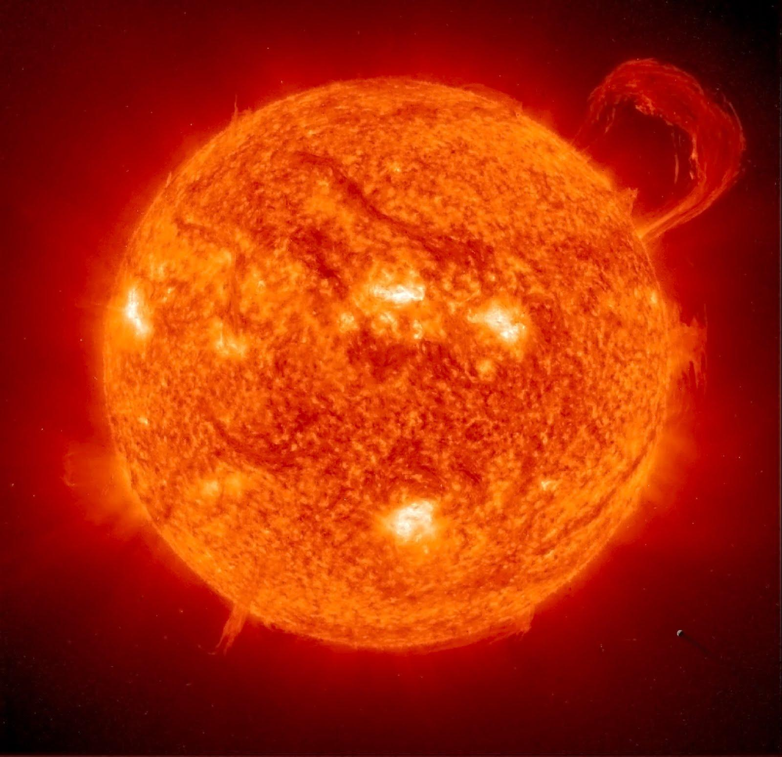
Week 1- Energy from the sun
We get heat energy from the sun.
Heat keeps us warm!
Notes:
Underlined words are part of the vocabulary list. Further explain the words to the students. Ask students what the image is.

Slide 3
We get light energy from the sun.
The sun provides light for the Earth.

Slide 4
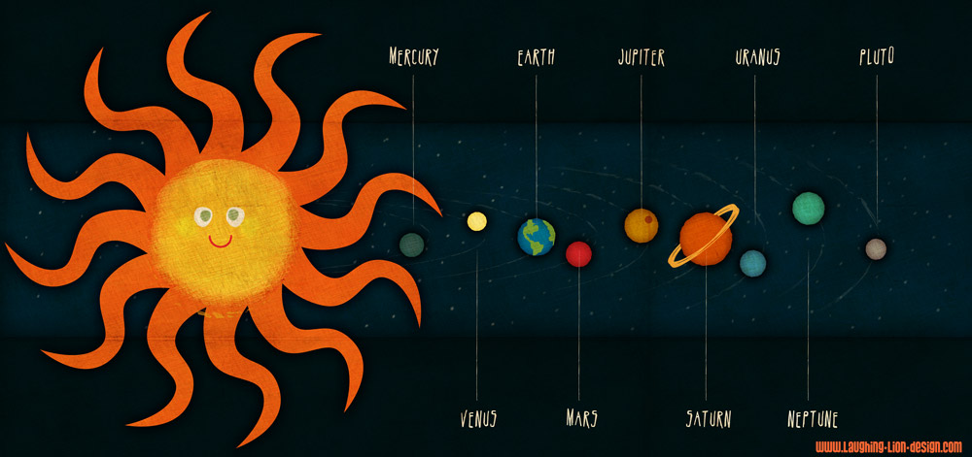
The Solar System
Notes:
Ask students to point out where we live.

Slide 5
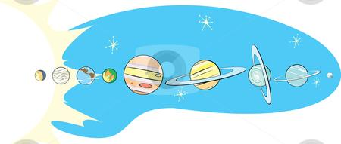
Solar System!
What is solar system?

Slide 6
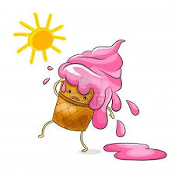
The Sun gives Earth energy!
Notes:
Ask the students what is happening to the ice cream because of the sun. The ice cream cone is melting because the sun’s energy makes it hot.

Slide 7
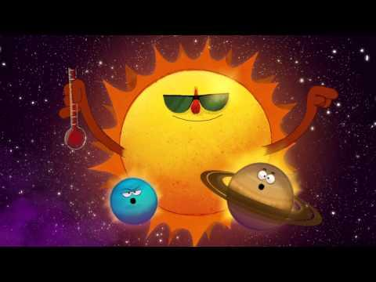
Video about the Sun!
Notes:
Have students answer the 5 questions on the video.

Slide 8
Questions
1. Do you feel that it is usually warmer during the day or night? Why?
2. How do plants and animals rely on the sun?
Notes:
Students should answer 1 by saying it is warmer during the day. For 2, plants and animals rely on the sun for warmth and energy to grow

Slide 9
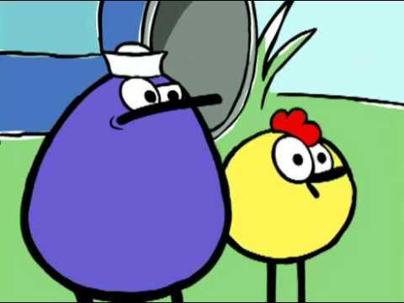
How the Sun makes plants grow!
Notes:
Have students answer the 5 questions.

Slide 10
Activity Time!
We are going to see how sunlight affects plant growth!
Notes:
Show how sunlight and shade affects the growth of plants.Refer to the guide for materials, procedures, and a worksheet for the students.

