Slide 1
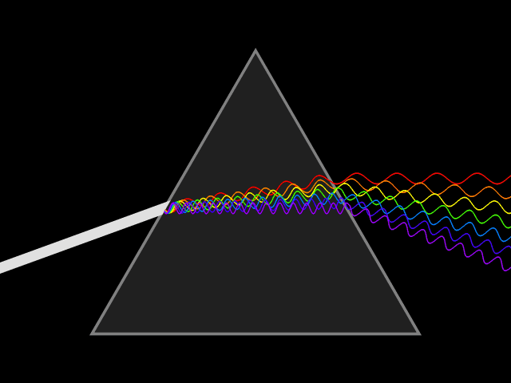
Week 5
Light waves

Slide 2
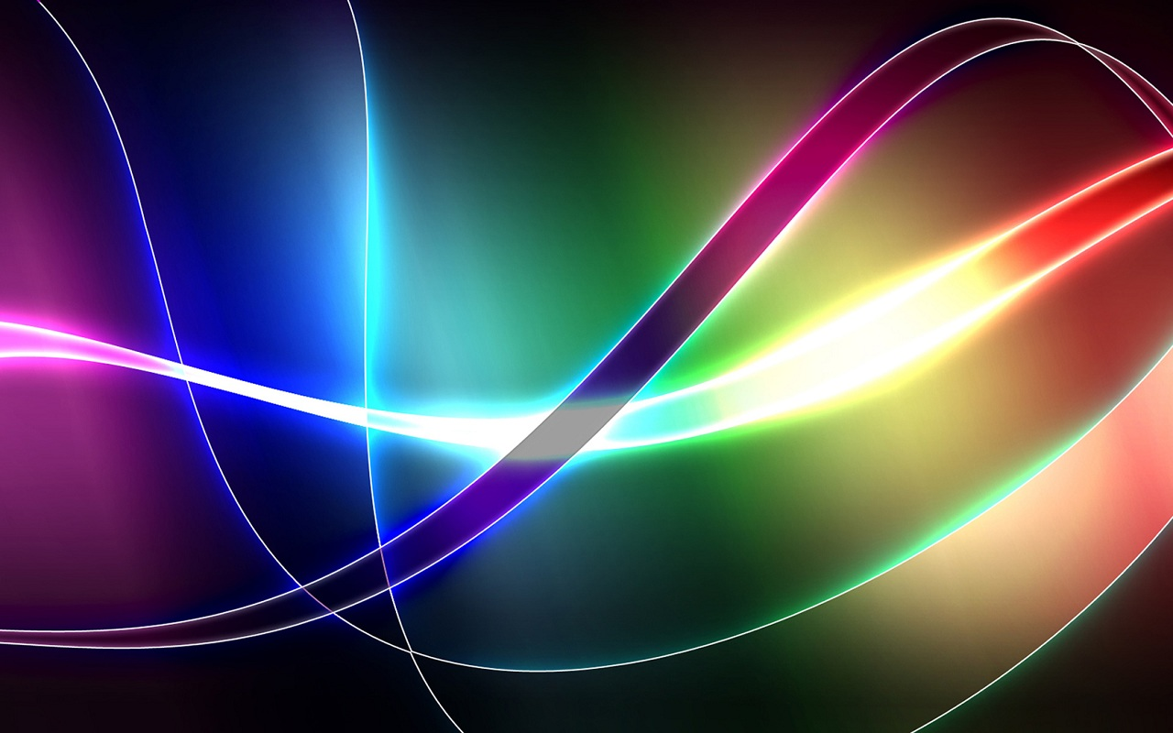
What are light waves?
Electromagnetic waves that travel through air
Produced by vibrating electrical charges
Transverse waves

Slide 3
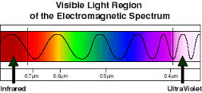
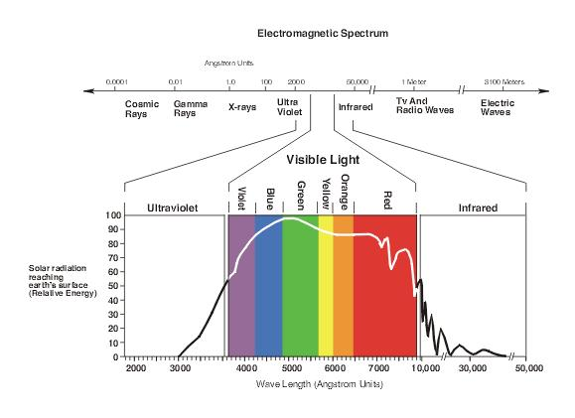
Light Waves
Visible light waves are the only electromagnetic waves we can see
The color red has the
longest wavelength
and violet has the
shortest
Notes:
Use the diagrams to explain the electromagnetic spectrum and how light is scattered and absorbed. Use examples of a real image and contrast it to a virtual image.

Slide 4
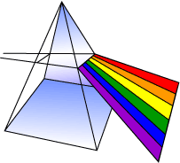
Primary Properties of Visible Light
frequency, or wavelength spectrum
intensity
direction
polarization

Slide 5
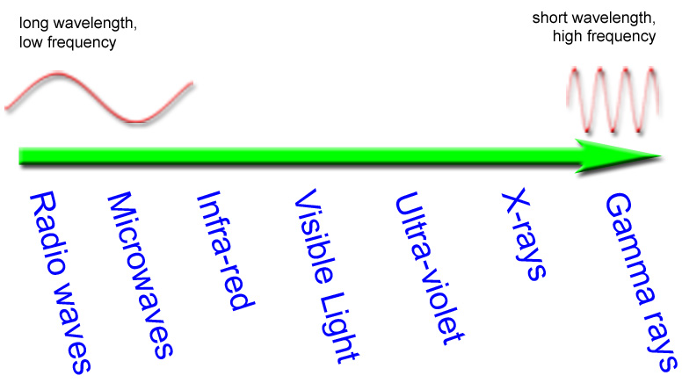
Electromagnetic Spectrum

Slide 6
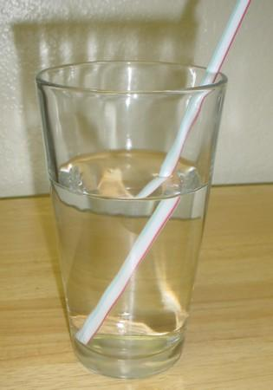
Refraction
the bending of light rays when passing through a surface between one transparent material and another
the wavelength of light changes but the frequency remains constant

Slide 7
Light waves vs. other waves
Electromagnetic radiation doesn't need a medium to travel through
Light can travel at 186,000 miles per second (300,000 kilometers per second). This is the speed of light
Speed of light is faster than speed of sound
Notes:
Use example of thunder and lightning.

Slide 8
Sources
http://www.sciencekids.co.nz/sciencefacts/sound.html
http://science.hq.nasa.gov/kids/imagers/ems/visible.html
http://csep10.phys.utk.edu/astr162/lect/light/waves.html
http://www.tsunami.noaa.gov/
http://www.stormsurf.com/page2/tutorials/wavebasics.shtml

