Slide 1
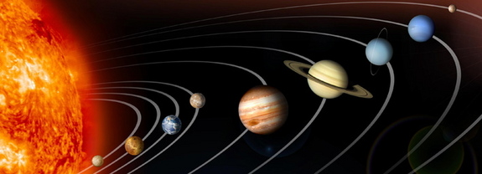
The Planets!
Notes:
Hi students, these are the planets in our solar system.

Slide 2
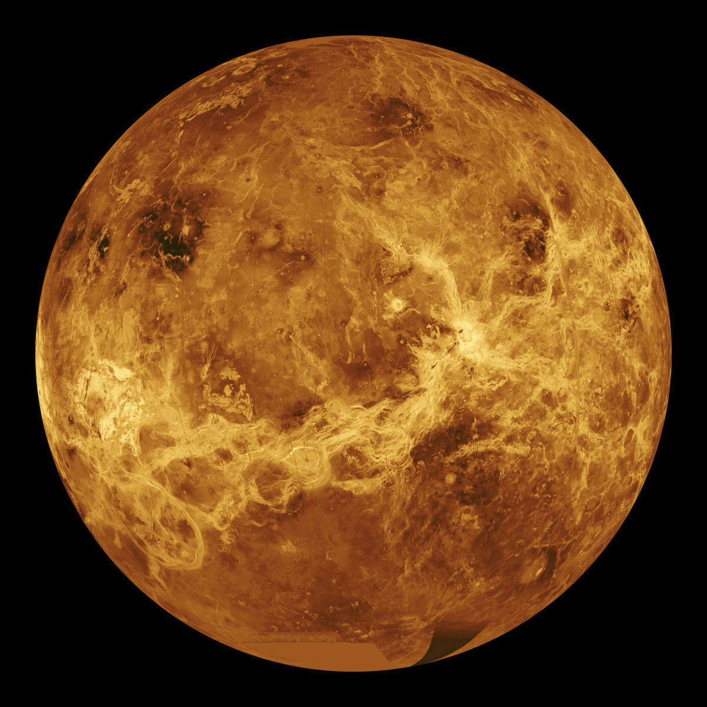
1. Mercury
Its the closest planet to the sun
Its the smallest planet in our solar system
Notes:
Mercury is the smallest planet in our solar system and closest to the sun.

Slide 3
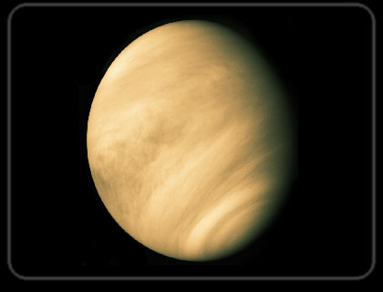
2. Venus
Atmosphere is thick and poisonous
Second brightest object in sky
Notes:
Venus is the second closest to the sun and has a poisonous atmosphere.

Slide 4
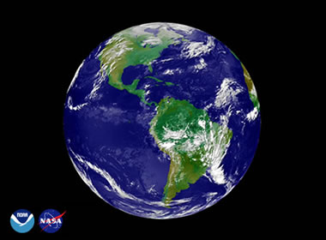
3. Earth
Its what we’re standing on
Is habitable
Notes:
Earth is the planet we live on and is the only known planet that can sustain life.

Slide 5
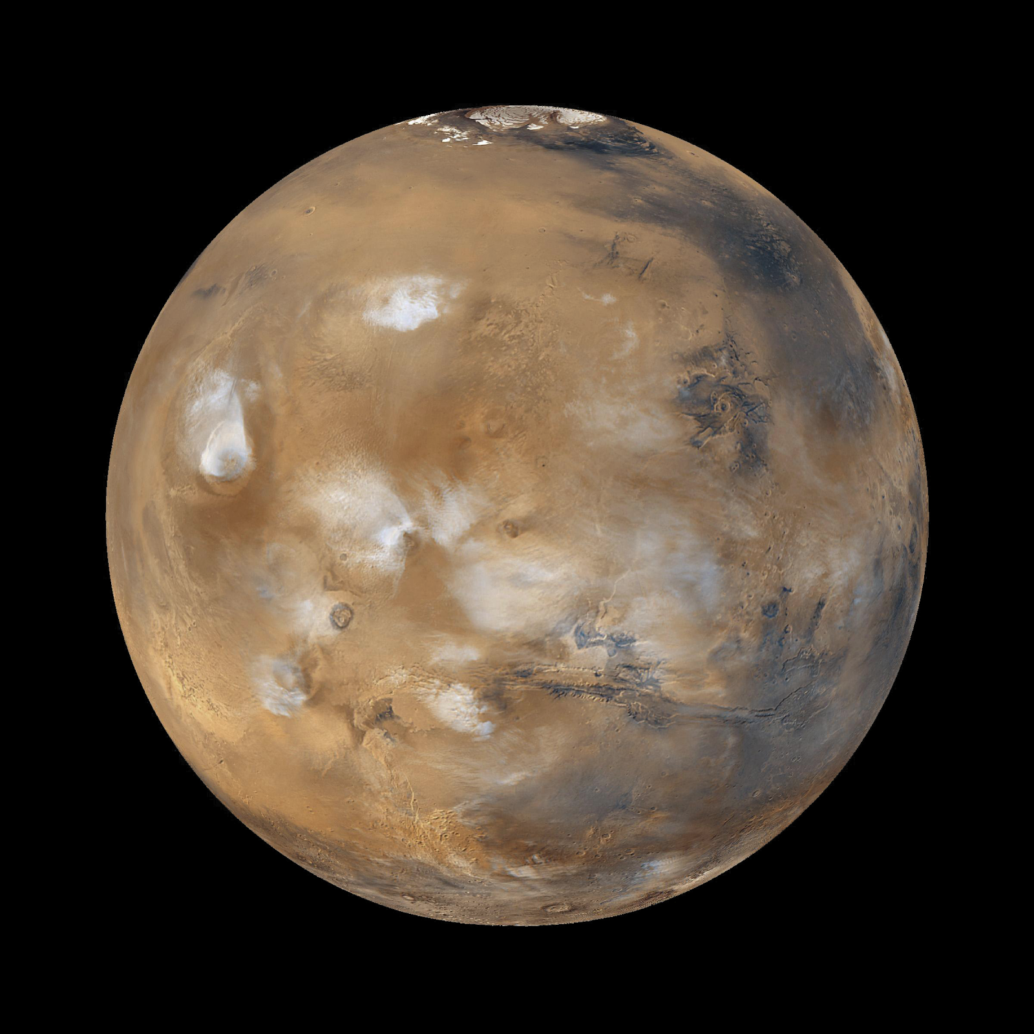
4. Mars
Known as the “Red Planet”
Lots of rocks and has no water
Notes:
Mars is the fourth planet from the sun.

Slide 6
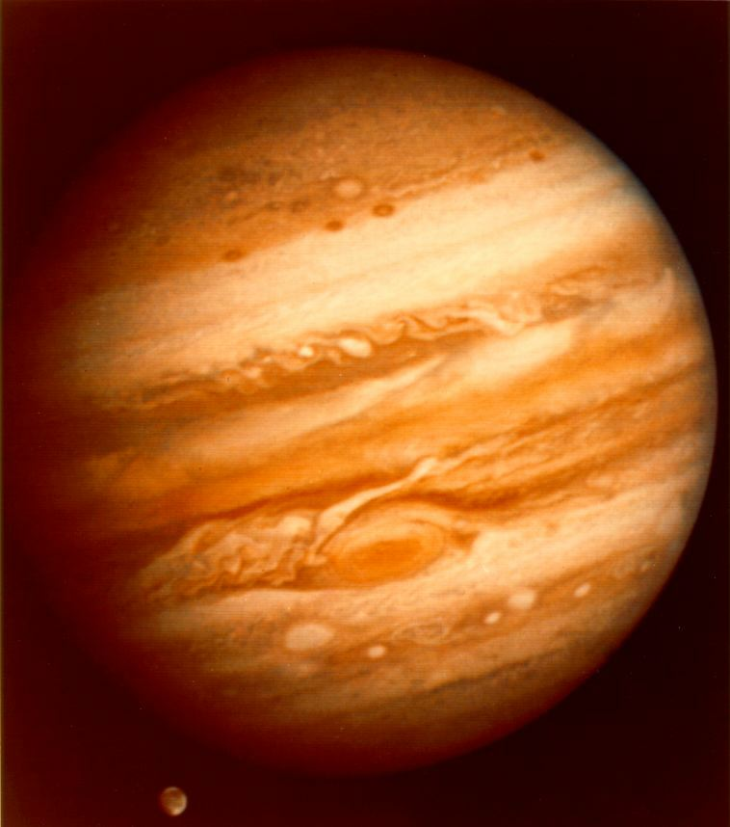
5. Jupiter
Has a giant red spot
Has 63 moons
Largest planet
Gas planet
Notes:
Jupiter is the largest planet in our solar system and has 63 suns.

Slide 7
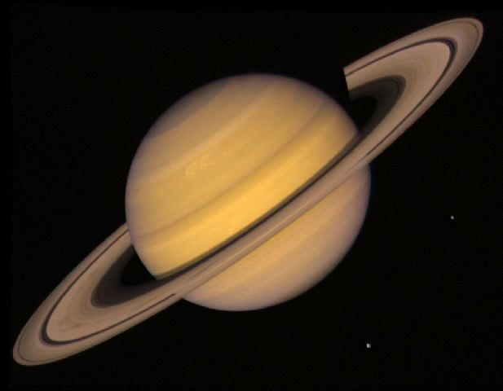
6. Saturn
Its rings are made of ice and rock
Has 53 moons
Gas planet
Notes:
Saturn is the sixth planet in our solar system and has beautiful rings.

Slide 8
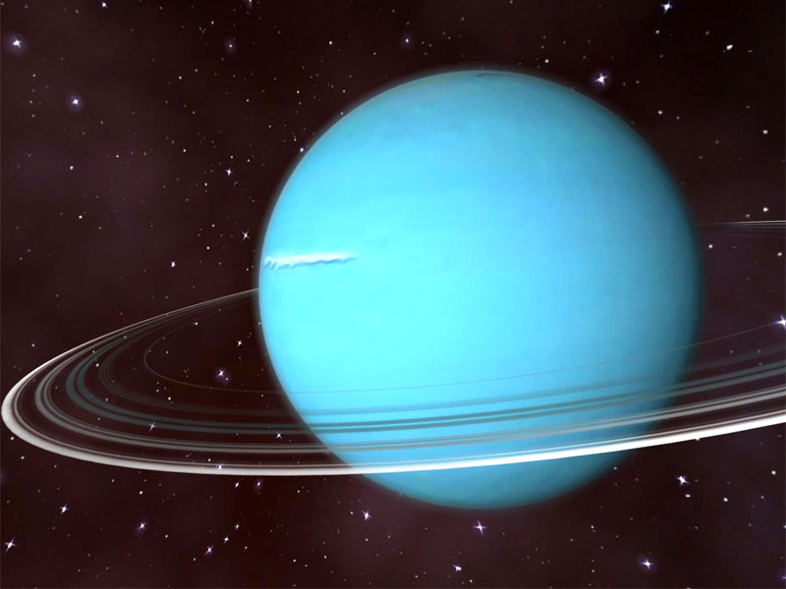
7. Uranus
Uranus’s seasons last longer than 20 years
Has 9 rings
Gas planet
Notes:
Uranus is the seventh planet in our solar system and has 9 rings.

Slide 9
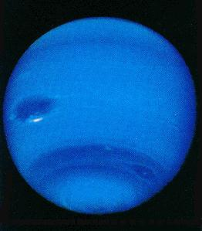
8. Neptune
60 Earths could fit in Neptune
Windiest planet in our solar system
Gas planet
Notes:
Neptune is now the last planet in our solar system.

