Slide 1
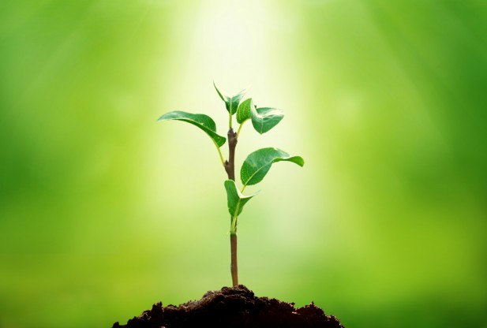
Plant Structures
Notes:
This is the title page of the powerpoint for this week.

Slide 2
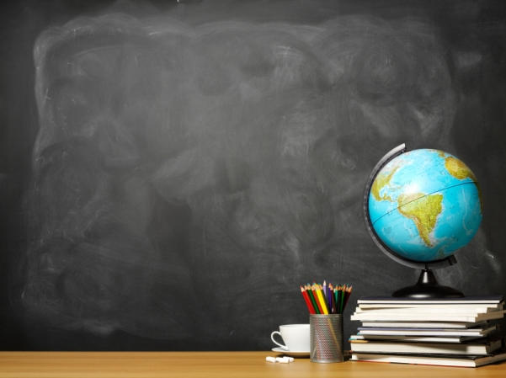
What you’ll learn...
• The many internal (inside) and external (outside) structures of plants
• How these structures work to support
survival, growth, behavior, and reproduction
Notes:
These are the lesson objectives and what the students will learn from the lessons of this week.

Slide 3
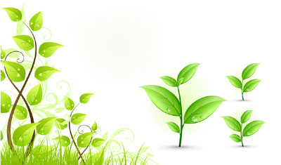
What are plants?
• Plants are 1 of the 2 groups into which living things are traditionally divided
Some characteristics:
- Multicellular
- Possesses cellulose
- Carries out photosynthesis
Notes:
• The other group is animals
• Main difference is that plants do not move while animals do
• Plants produce their own food while animals hunt for food
• Photosynthesis is the process in which plants produce food

Slide 4
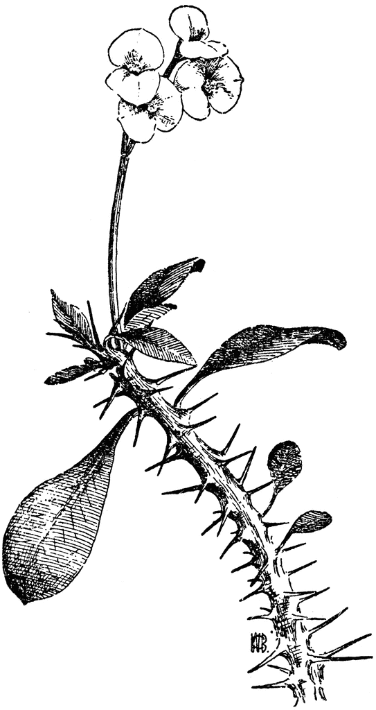
Thorns
• Thorns protect plants
• Plants cannot move, so they need to be able to protect themselves
• Plants thorns were evolutionarily selected over time.
Notes:
• Thorned plants provide beauty, food and function.
• Because plants are incapable of fleeing from attackers, they need defenses. Some of these defenses are physical, like thorns. Other defenses are inducible, and generally chemical in nature (and also one of the reasons we get such a plethora of drugs from plants).

Slide 5
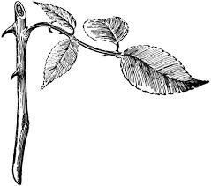
Stems
• Support leaves and flowers
• Transports water and food within the
plant
• Cylindrical in shape, usually branched and leafy
Notes:
• Stems may be both soft and hard

Slide 6
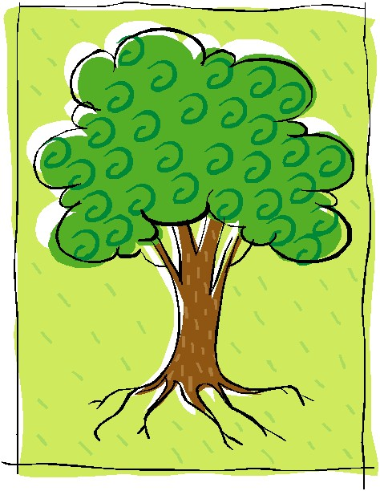
Roots
• Roots absorb water and nutrients from the soil
• They keep plants in the ground
• They act as a storage for some plants
Notes:
• Plants like beets or potatoes have roots that function as food and water storages

Slide 7
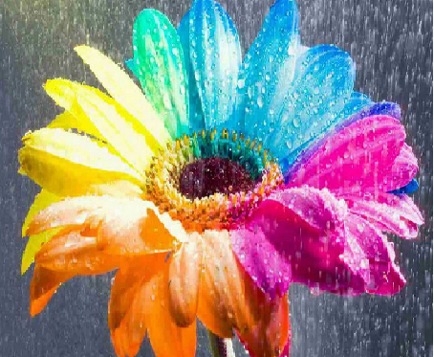
Colored Petals
• The colors of petals attract pollinators like bees and butterflies
• Petals produce nectar
• Protects certain parts of the plant
• Mainly functions as an aid to pollination
Notes:
• Petals may be scented
• The petals protect female and male reproductive parts of flowers

Slide 8
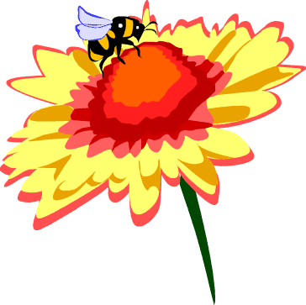
Pollination
• Pollen is moved from the male part of the plant (the anther) to the female part of the plant (the stigma).
• Pollination results in fertilization, which then results in reproduction
• Animals such as birds and insects move the pollen around and act as “pollinators”

