Slide 1
Week 3
Sound Waves

Slide 2
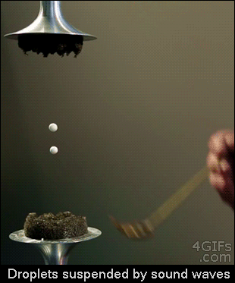
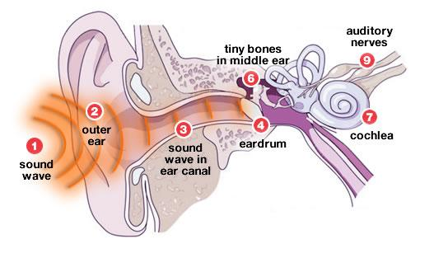
Sound Waves
Sound comes from vibrations
Sound moves faster in water
We use our ears to hear vibrations which turns into sounds
Notes:
Explain that different frequencies can be heard by different ears and that what humans perceive is different from what other animals perceive. Review the basic structure of the human ear and how it receives sound.

Slide 3
Sound Waves
Sound waves differ from each other
Sound waves can be helpful to us
Sound may also hurt our ears
Notes:
Use the example of bats and their utilization of echolocation to locate food. Explain the concept of resonance, sound interference, infrasonic, and ultrasonic.

Slide 4
Sound waves differ from each other by:
Pitch - How long or how high you perceive a sound to be
Loudness - How loud or soft a sound is perceived to be
Echo - A reflected sound wave

Slide 5
Sound Waves can be helpful to us.
Sound waves allows us to communicate with one another.
Can allow us to find objects through Echolocation - the process of using reflected sound waves to find objects.
Sound can warn us about things that are about to occur.
Ex. Thunder signaling a storm is near.

Slide 6
Sound may also hurt our ears.
When sound is too loud and hurts our eardrums, we may result in loss of hearing and may possibly become deaf.
An example may be from experiencing a Sonic Boom - the explosive sound heard when a shock wave reaches your ears.
Today in many cities people experience noise pollution. Noise pollution is unwanted or disturbing sound.

Slide 7
How do we perceive sound waves
Sound waves travel through the ear by the ear canal(3) to the eardrum(4). The sound waves then travel to the cochlea (7) which is filled with tiny hair cells. These hair cells detect the sound waves and process them as electrical signals to the brain by the hearing nerve (9). The brain then allows us to know what the sound is.
Notes:
Point to labeled areas while explaing the process in which sound waves travel through our ears.

Slide 8
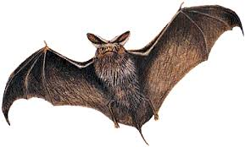
How Do Bats Fly In the Dark
Bats use a method called echolocation
Echolocation is when the bats emit a high frequency sound that bounces off cavern walls and rebounds back into their ears so they can locate where obstacles exist
They also use this method for hunting

