Slide 1
Week 1
Ocean Waves

Slide 2
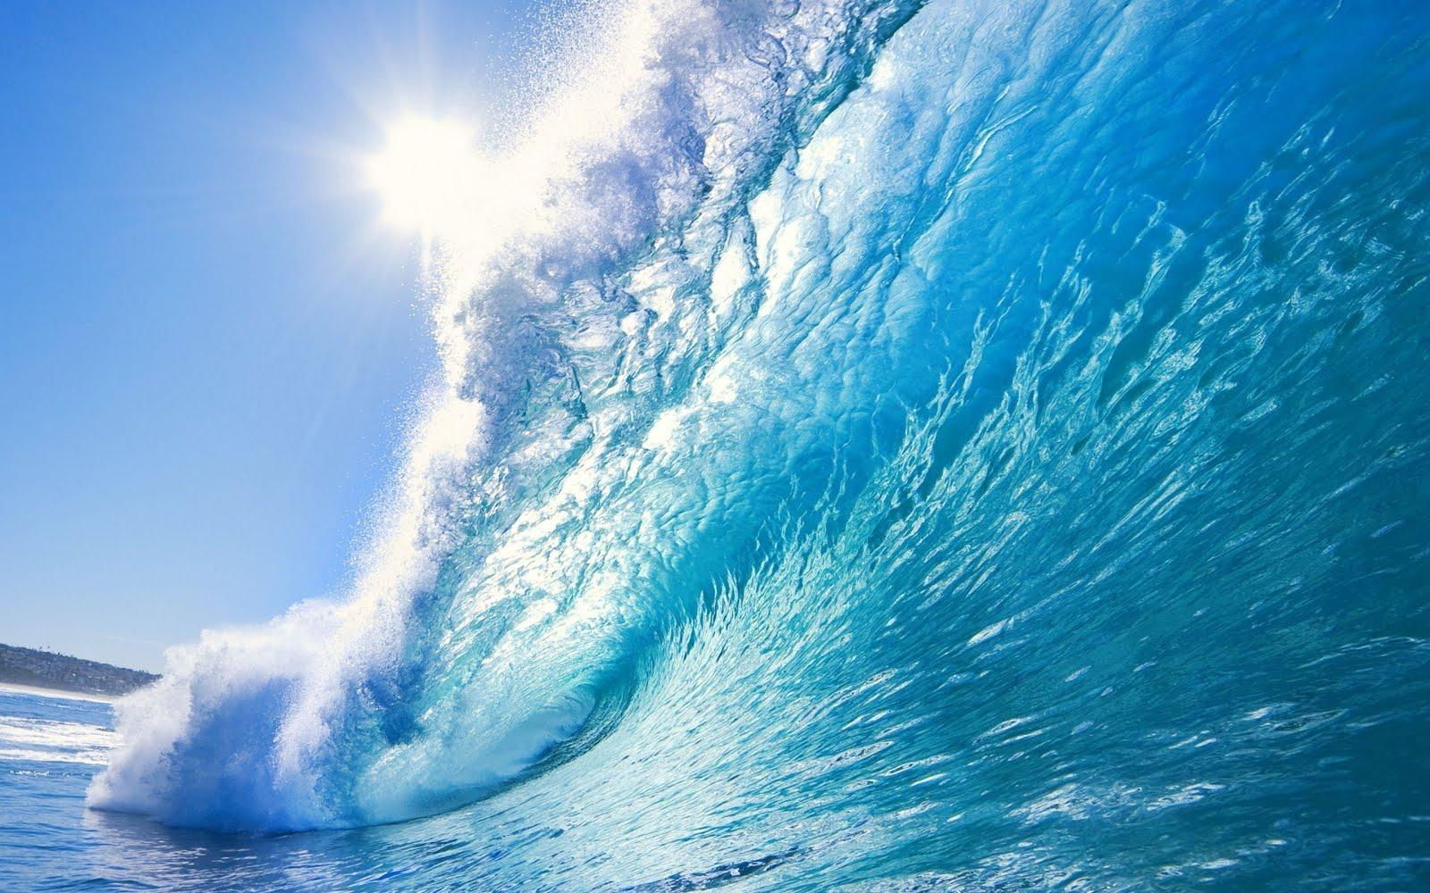
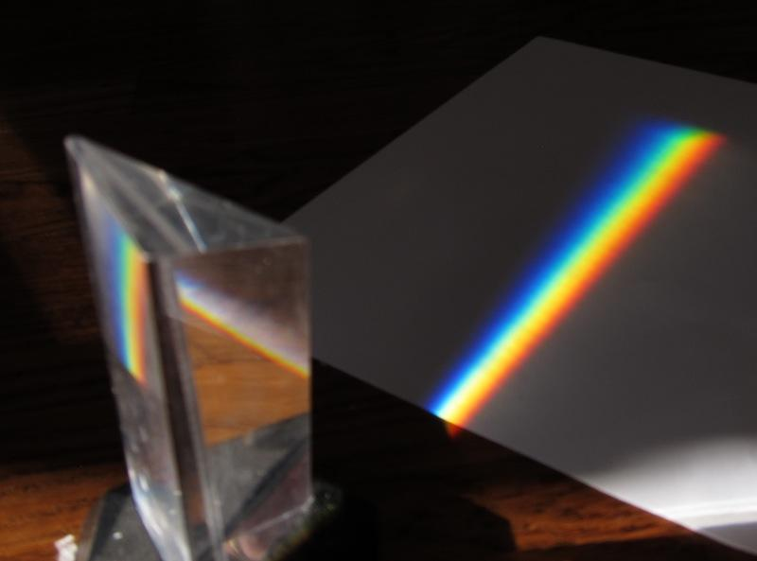
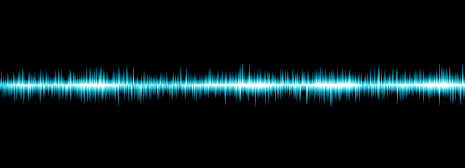
What kind of waves are there?
Ocean Waves
Sound Waves
Light Waves
Notes:
The teacher should ask if students have been to the beach and explain that the ocean is a form of energy. Ask if they listen to music and help them understand how sound works. Explain that light bounces off objects and its different abilities to reflect and refract.

Slide 3
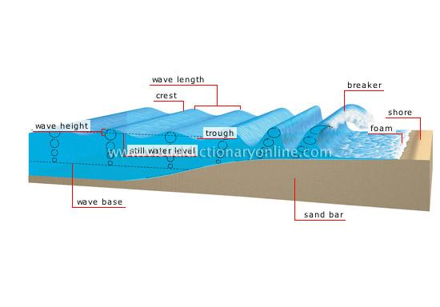
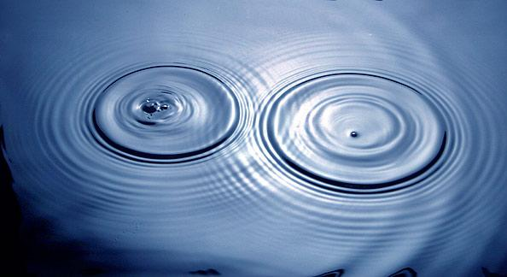
What are ocean waves?
a long body of water curling like an arch and breaking onto the shore
waves are disturbances that spread energy
are regular patterns of motion
that can be made in water
by disrupting the surface of it
Notes:
Explain the concept of diffraction and refraction. How are these waves made, what influences them. Have students write responses and share with one another before revealing the answer,

Slide 4
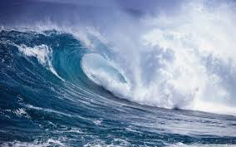
Characteristics of a Wave
Wavelength-the distance from one peak to another
Period- the time it takes from one peak to pass through a given point
Frequency- the number of cycles passing by in a given time.

Slide 5
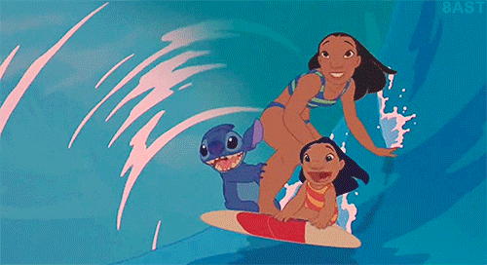
Ocean surface waves
caused by wind moving across the surface of the water
Water only moves up and down as they travel from the wind
Notes:
Give them multiplication problems concerning the speed of ocean surface waves. Test them on the different types of waves (transverse, longitudinal)

Slide 6
Surface Waves Cont’d
Surface Wave- Wave that consists of a combination of transverse and longitudinal waves and occurs at the surface between two different mediums

Slide 7
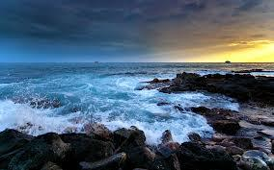
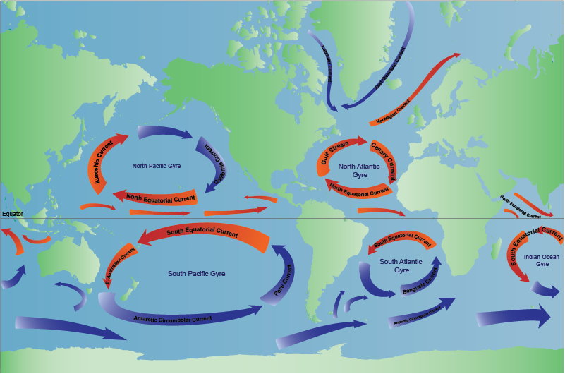
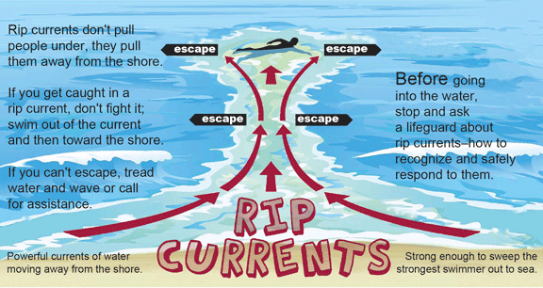
Waves vs Currents
Ocean currents are a constant motion of water
Ocean waves are energy traveling through water
Notes:
Explain ENSO and its effects on the world, on different habitats such as coral reefs, and how humans are affecting them.

Slide 8
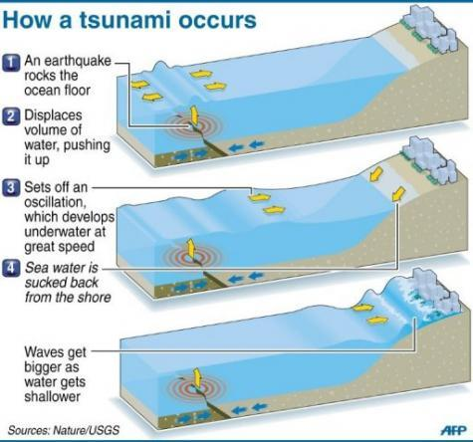
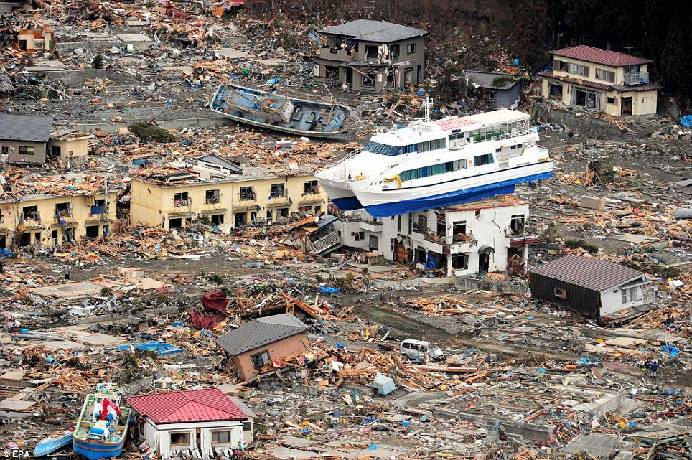
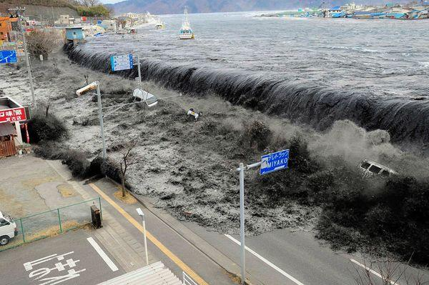
Tsunamis
A type of ocean wave
A series of ocean waves and are usually much bigger in size compared to regular ocean waves
Caused not by wind but by earthquakes, volcanoes, and landslides
Notes:
How are tsunamis formed and what happens to sediment when they reach land. Give them examples of different tsunamis and touch on the concept and movement of tectonic plates.

