Slide 1
Week 2
Uses of Ocean Waves and more

Slide 2
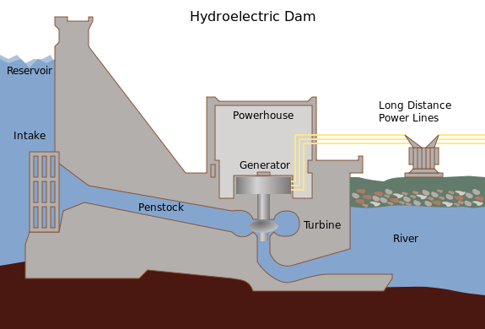
What can ocean waves be used for?
hydropower
Terminator devices
Attenuators
Point absorber
Overtopping devices

Slide 3
Why is hydropower beneficial?
Hydropower is a renewable source of energy meaning it can be used multiple times without running out
Most of our energy is from fossil fuels which is not renewable
Fossil fuels damage the ozone layer with gas emissions
Notes:
Review why the ozone layer is important to us. Describe the hole in the ozone and how using renewable energy sources can help prevent the hole from getting bigger.

Slide 4
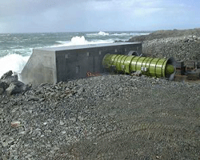
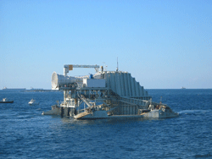
Terminator devices
captures or reflects the power of the waves
wave causes the captured water to move up and down, forcing air through an opening to a turbine to generate power
Notes:
Students may find it hard to picture how this device creates energy so, a video may be helpful to show.

Slide 5
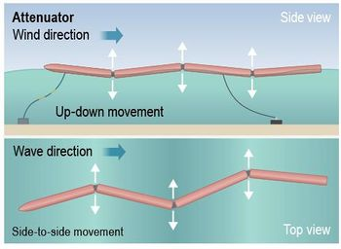
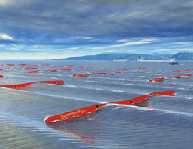
Attenuators
long floating structures that go along with the direction of waves
hydraulic pumps or other converters generate power with wave movements

Slide 6
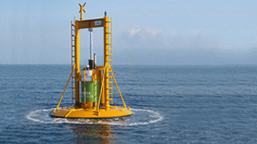
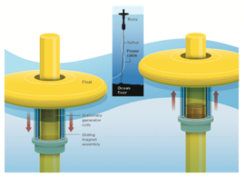
Point absorber
floating structure that move relative to wave action
The rise and fall of the wave height at a single point for energy conversion
up and down motion caused by passing waves is used to drive electromechanical or hydraulic energy to generate power
Notes:
Compare and Contrast: point absorber and attenuators. Students may get confused by the two since they are similar.

Slide 7
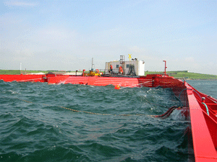
Overtopping devices
Are like reservoirs and cause buildup of water like a dam
The water is then released, and flow back into the ocean
The energy of the falling water is used to turn hydro turbines to generate power

