Slide 1
Week 3- Sun’s Effect on Earth’s Surface: Sand and Grass
The sun warms different surfaces by different amounts.

Slide 2
Imagine that a pan is filled with grass or sand. How do you think the sun would affect the warmth of those items? Why?

Slide 3
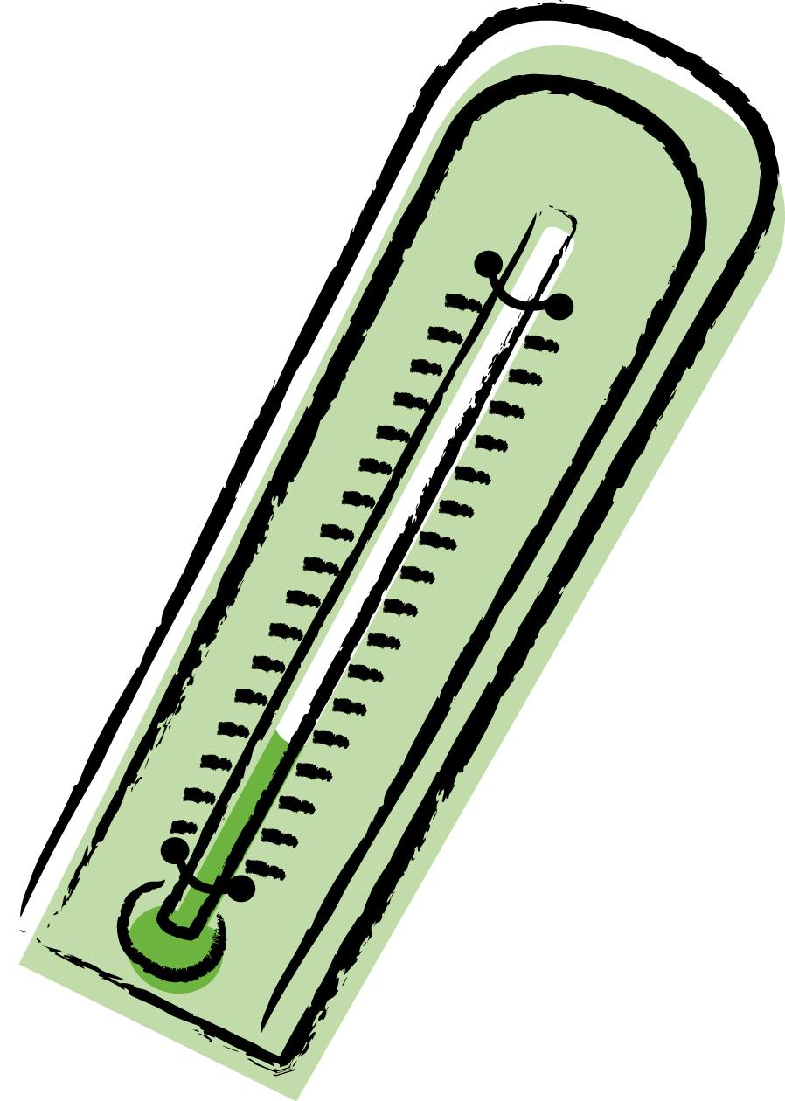
What do we use to measure how hot it is?
Notes:
Explain to the students what a thermometer is.

Slide 4
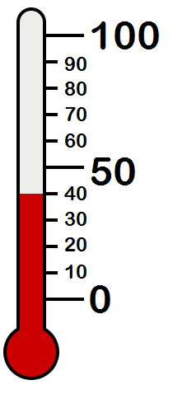
What is temperature does this thermometer say?
Notes:
Temperature is the measure of the amount of heat. The thermometer reads 40.

Slide 5
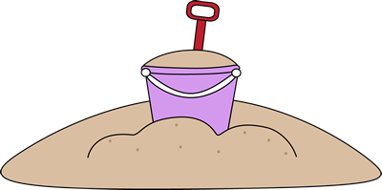
Sand and Grass Experiment
We are going to set up an experiment in our room to test how the sun warms grass and sand.
Notes:
Refer to the planning guide, it will list all the materials and procedures.

