Slide 1
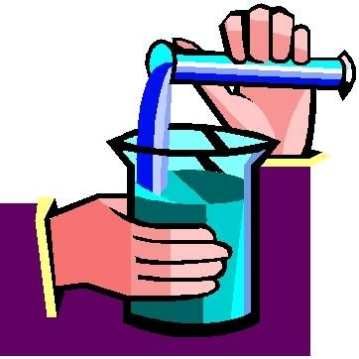
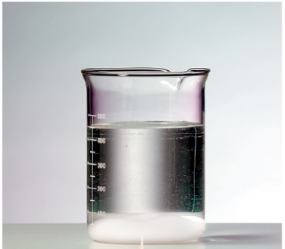
WEEK 5-SOLUBILITY

Slide 2
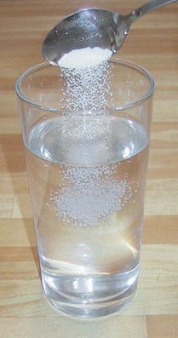
SOLUBILITY
the MAXIMUM amount of solute that dissolves in a specific amount of solvent
Mixture of one substance dissolves evenly in another
Notes:
What is solubility?(read the green word box), and, in a more simpler explanation, It is a mixture of one substance dissolves evenly in another. Can anyone give me a example? EX: Salt in water, sugar in water etc. Now what is a solvent and what is a solute? like what we learned few weeks before, a solution is made of (change slide)

Slide 3
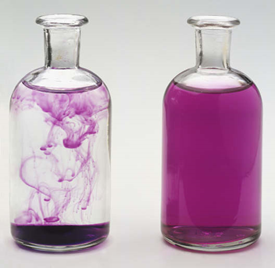
SOLUTION
A solution is made of two parts, the solvent and the solute.
SOLVENT
SOLUTE
Notes:
Solvent is the liquid, so for example, WATER. SOLUTE is the SOLID, for example, salt.

Slide 4
Mixture
a combination of two or more substances where each keep their own properties and can be easily separated
Notes:
(read the definition) so for example, the picture on the slide is a mixture of different flowers

Slide 5
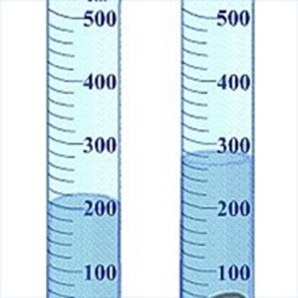
Volume
the amount of space that an object or substance occupies

Slide 6
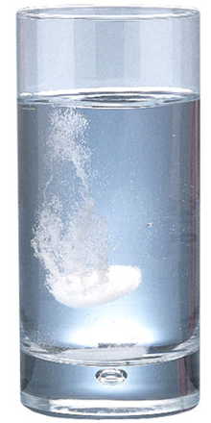
DISSOLVE
to break down and spread evenly in a liquid

Slide 7
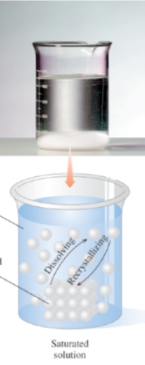
SATURATED
Saturated solutions contain
the maximum amount of solute that can dissolve
some undissolved solute at the bottom of the container
DISSOLVED SOLUTE
UNDISSOLVED SOLUTE

Slide 8
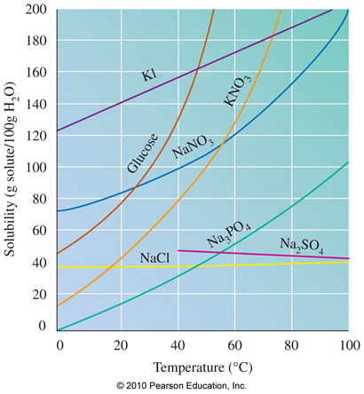
Effect of Temperature on Solubility
Solubility
-depends on temperature
-of most solids increases as temperature increases
-of gases decreases as temperature increases
Notes:
For example, the warmer the water is , the faster the salt in the water will dissolve and so that means the solubility of salt-solid, is higher.

Slide 9
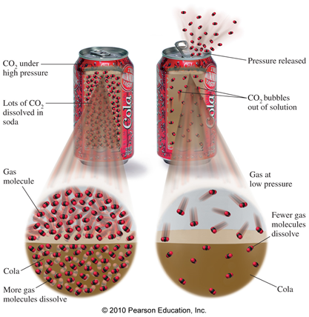
Henry’s law
the solubility of a gas in a liquid is directly related to the pressure of that gas above the liquid
at higher pressures, more gas molecules dissolve in the liquid
Notes:
For example, when a soda can is not opened, the high pressure will force the air molecule inside, making more gas molecule dissolve. However, after you opened the soda can, the pressure is gone and the gas molecule will escape and thats why when you open a soda can, there will be bubbles, which means the gas molecules are escaping.

Slide 10
POP QUIZ
1) Define saturated solution
2) What is the difference between an solute and a solvent?
3) Fill in the blank:
Solubility of most solids _______ as temperature increases
Notes:
POP quiz, to write on a half sheet of paper and turn in after finished. Give them 5 minutes.
1)contain
the maximum amount of solute that can dissolve
some undissolved solute at the bottom of the container
2) Solute-Solid, Solvent-liquid
3) Increases

