Slide 1
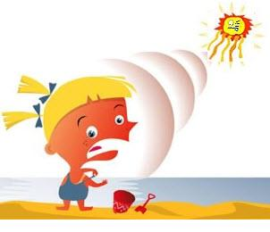
Week 5- Sun Protection!
The sun is very strong and has gives off UV rays.

Slide 2
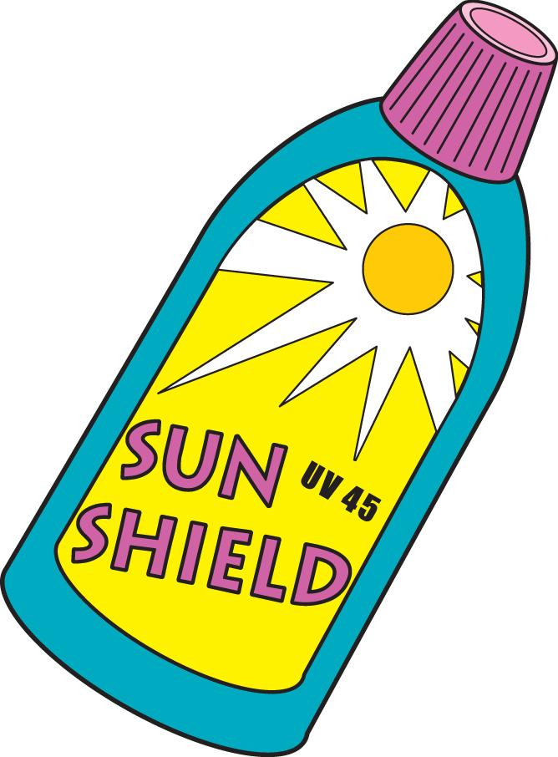
Wear sunscreen to protect yourself from sun rays

Slide 3
Wear a hat and sunglasses!
Don’t look at the sun!
You could hurt your eyes!

Slide 4
Stay in the shade if you feel hot
Stay hydrated!
Notes:
Hydrated

Slide 5
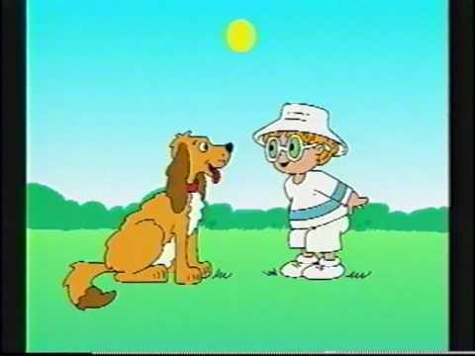
Sun Safe Play Everyday!
Notes:
Have students answer the 5 questions.

