Slide 1
Weather & Climate
Week 2

Slide 2
Describe the weather!

Slide 3
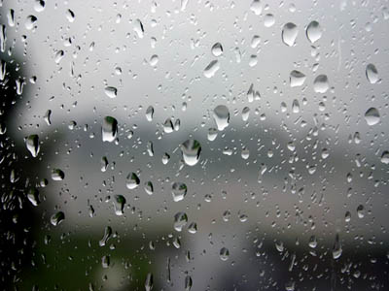

Slide 4
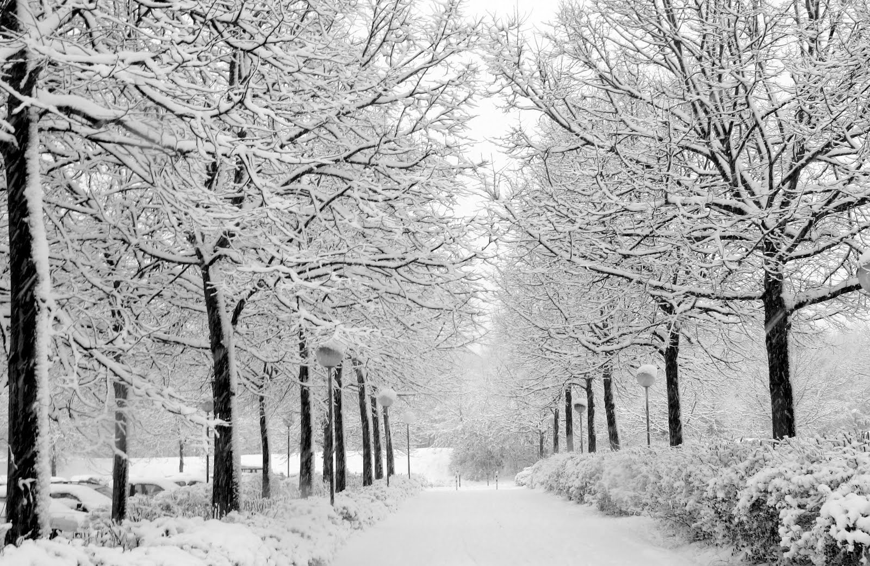

Slide 5
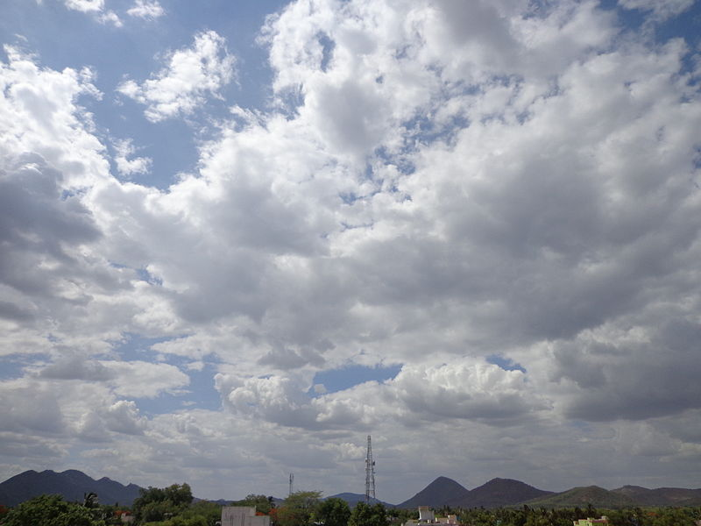

Slide 6
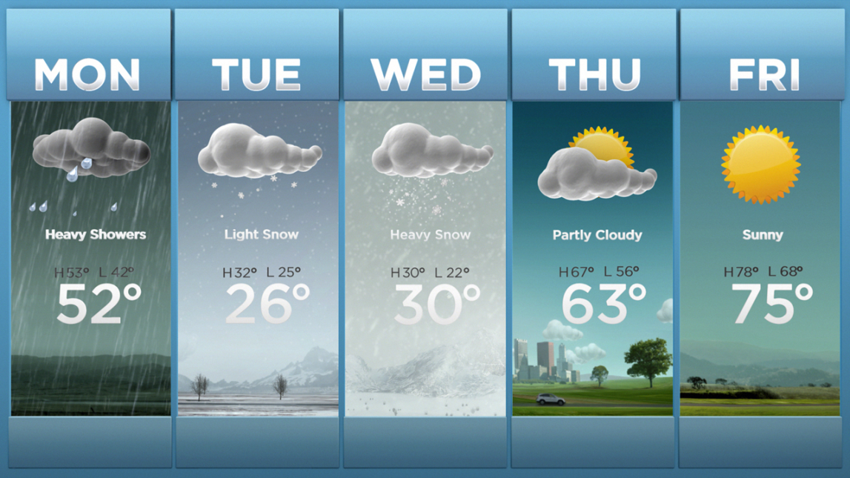
How to predict the weather?
Temperature is a number that shows how HOT or COLD it is!

Slide 7
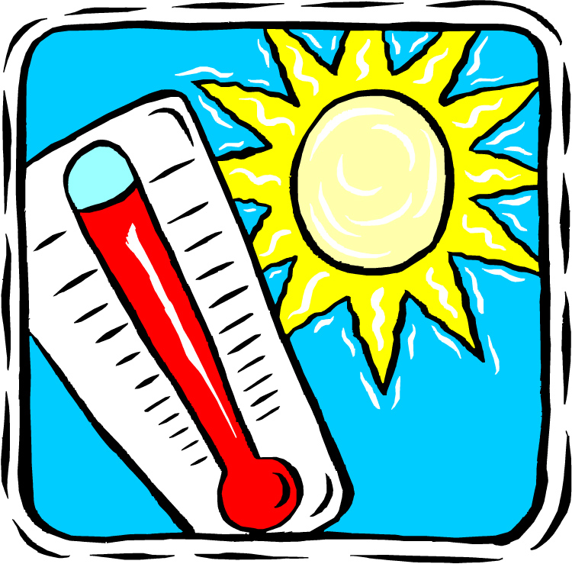
We use a thermometer to measure the temperature outside

