Slide 1
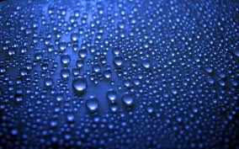
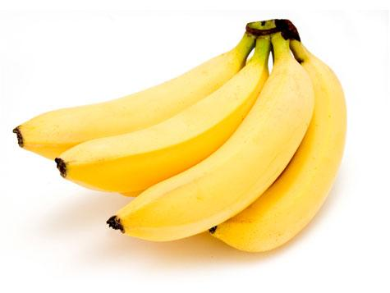
Cellular Respiration
Word Bank
Oxygen
Water
Carbon Dioxide
What is Cellular Respiration?
Cellular respiration is what cells do to make energy.
Directions: Fill in the blank
Did you know?
Cellular Respiration happens in all forms of life, including us as well!
________________
Food/ glucose
______________
The air we breath out
_________
The air we breath in
Energy

