Slide 1
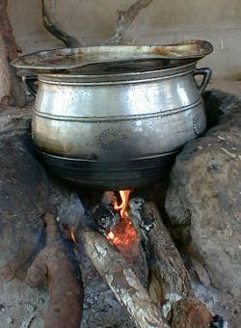
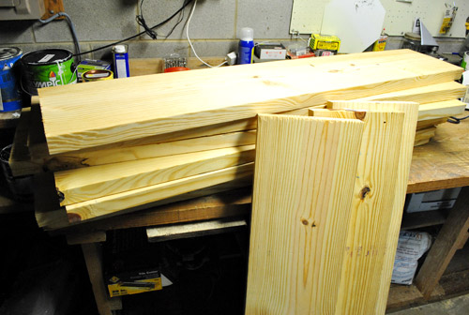
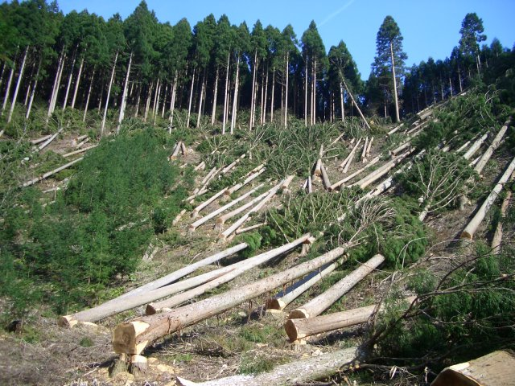
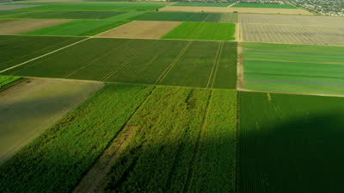
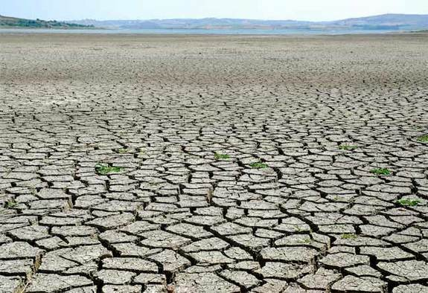
Word Bank
Farming
Animals
Cooking
Deforestation:
What is deforestation?
Deforestation is the clearing of trees in rainforests.
Fill in the blanks
Wood used for
___________
Deforestation
Wood used for
building supplies
Land cleared for
__________
Floods and droughts
____________
Notes:
http://www.acgc.ca/09/images/file/developmentinabox/G3-CHFdeforest.pdf

