Slide 1
now you can make your own habitat!
Notes:
begin the Butterfly habitat lab

Slide 2
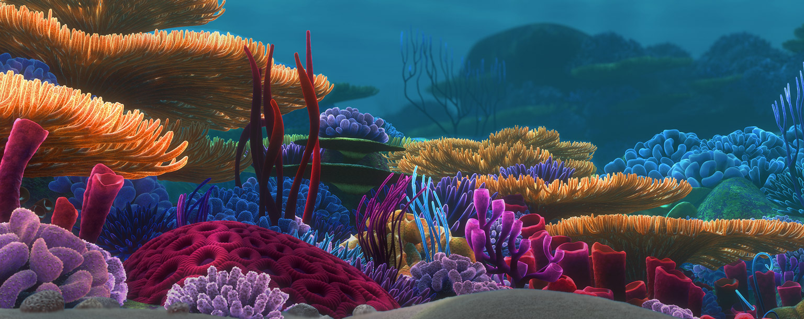
Habitat
home of an animal, plant, or organism
Notes:
Ask “who lives in this habitat?” Name another example of a habitat and what lives in it.

Slide 3
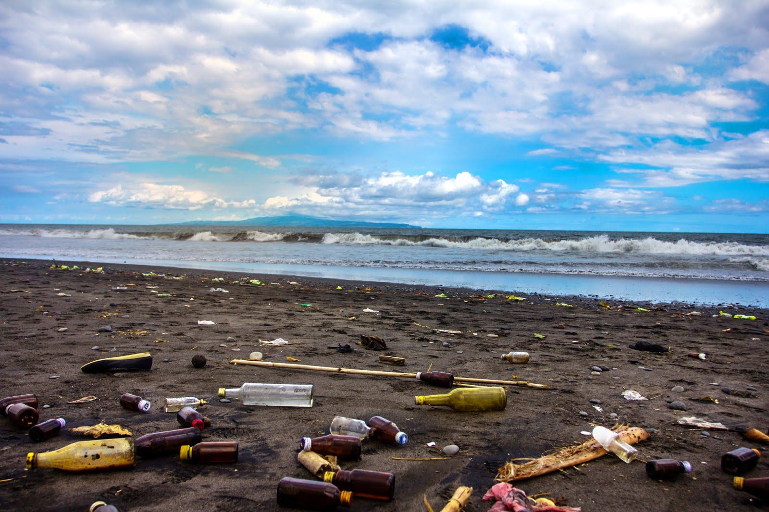
Habitat Alteration
change in pollution from pollution or overcrowding

Slide 4
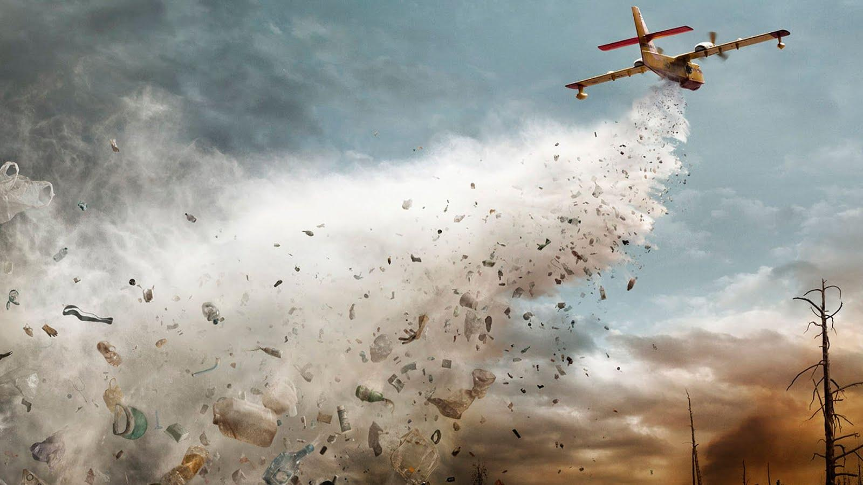
Pollution
any substance that has a harmful or poisonous effect

Slide 5
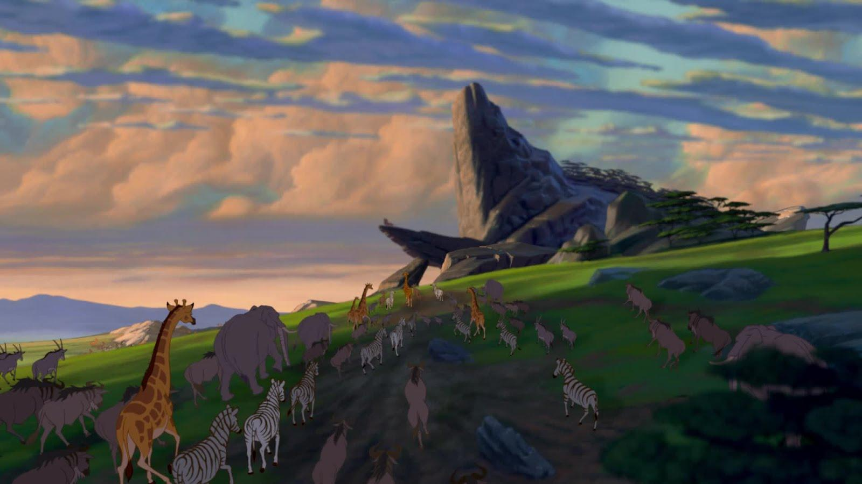
Effects of habitat alteration
animals have to migrate to different places

Slide 6
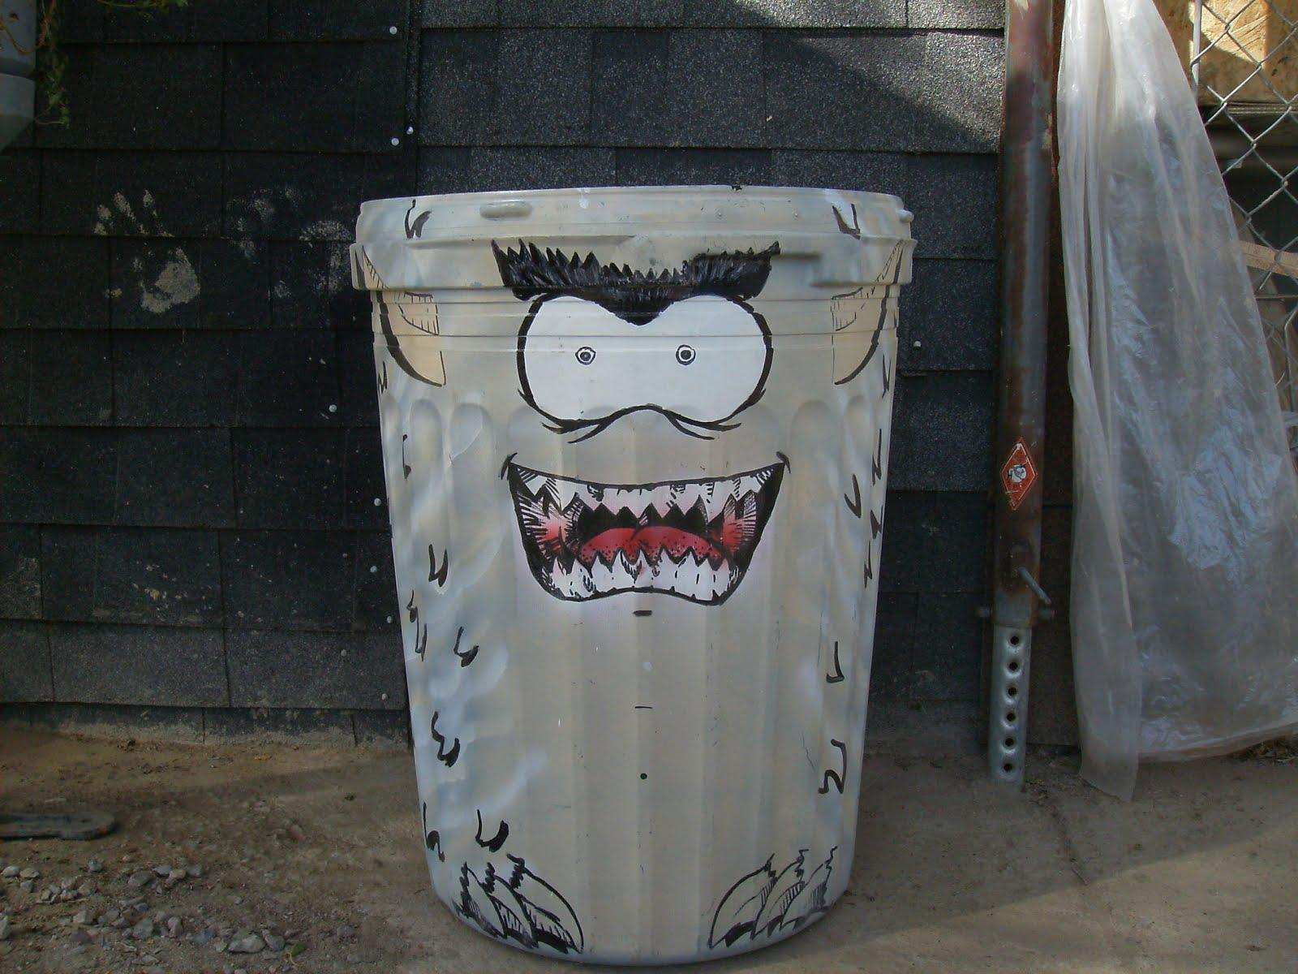
TRASH
anything that is considered waste

