Slide 1
Plate Tectonics
- is the movement of enormous sections of Earth’s crust—the plates.
- New crust forms where plates separate on the seafloor, and existing crust sinks into the mantle
Notes:
Lesson 8 Give examples where this type of thing happens.

Slide 2
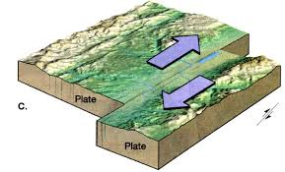
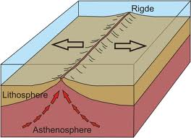
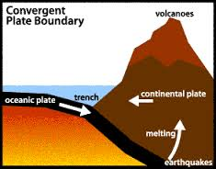
Transform:
is an actively deforming region where two (or more) tectonic plates or fragments of the lithosphere move toward one another and collide.
Convergent:
is the process that takes place at convergent boundaries by which one tectonic plate moves under another tectonic plate and sinks into the mantle as the plates converge.
Divergent:
is a linear feature that exists between two tectonic plates that are moving away from each other.
Notes:
Use props to help the students learn each type visually so that they can fully understand each process. Possibly use a deck of cards.

Slide 3
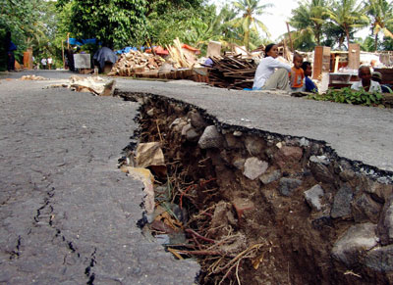
Movement of
Plate Tectonics
Earthquakes: a sudden and violent shaking of the ground, sometimes causing great destruction, as a result of movements within the earth's crust or volcanic action.
Notes:
Give examples of great earthquakes that occurred in history. Have a demo with clay and try shifting the bottom part of the clay. The result would cause the surface to crack. Which is an example of an earthquake affecting the surface.

Slide 4
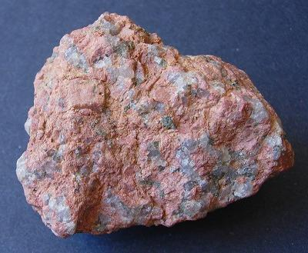
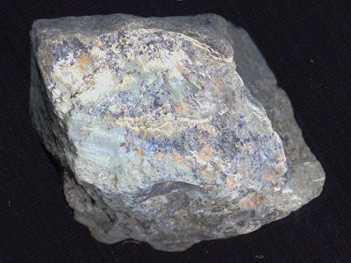
How rocks form
- Deep inside the Earth the temperature is very hot. It is so hot that it melts rock.
- The melted rock is called magma. When a volcano erupts the magma pours out. - When magma comes out of the volcano it is called lava. Once it cools it becomes igneous rock.
IGNEOUS ROCK
Notes:
Bring igneous rocks to class so the students can have examples that they can look at and feel the textures of the rocks.

Slide 5
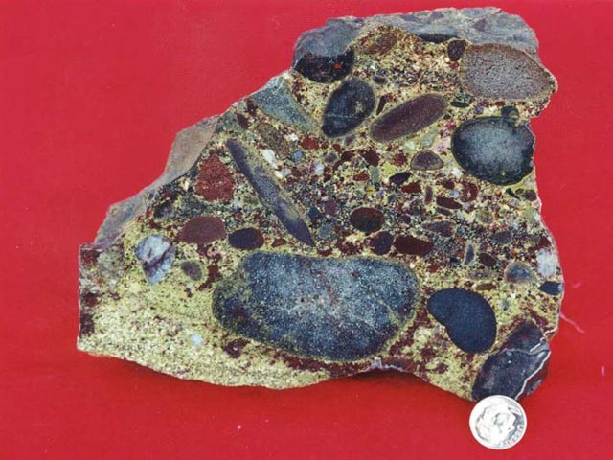
SEDIMENTARY ROCKS
- rocks break down through weathering.
-The broken rocks turn into sediment.
-Sediment is cemented into sedimentary rocks.
Notes:
show that all the stones and scraps in the picture were compressed into the rock

Slide 6
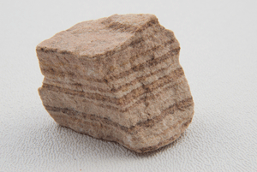
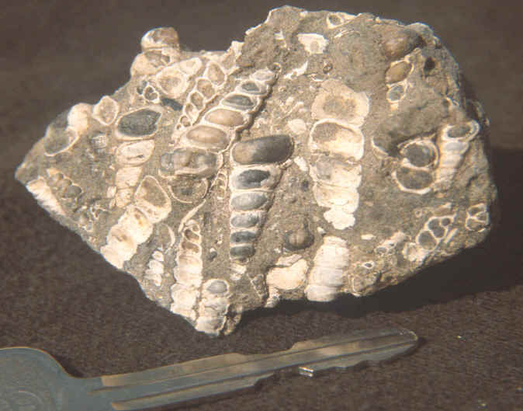
SEDIMENTARY ROCKS
Sedimentary rocks are made at the surface of the Earth, not deep underground like metamorphic rock.
-Because sedimentary rock is made from layers of sediment, this is the kind of rock in which you find dinosaur fossils.
Notes:
use the pictures as examples and explain that the crustaceans in the rocks are compressed and fossilized so when u break into a rock especially near the beach, you can likely find these, then for the picture on the top right explain how and why there are different sediment layers and ask them which one is probably the oldest

Slide 7
How is metamorphic rock formed?
- The weight of the ground presses down on rocks that are deep under the surface. - Metamorphic rocks are made when underground rocks are pressed and heated.
-They are not hot enough to melt and turn into magma, but they are heated enough to change them from sedimentary to metamorphic.
ITS STILL HAS LAYERS AND CONTAINS SEDIMENTS!!!!!!
Notes:
explain that although its called metamorphic, its still contains sediments creating more layers

Slide 8
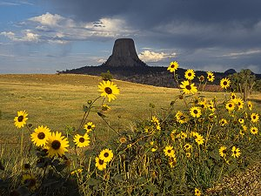
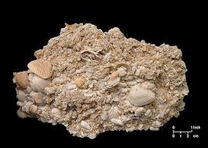
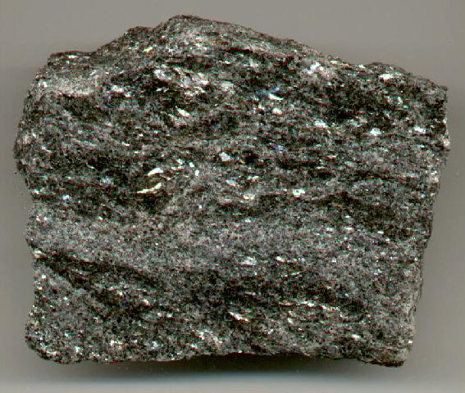
Review!!!
What kind of rock are these?
Notes:
Lesson 9 give hints if they don't get it, and first one starting from left to right is igneous, then metamorphic, then sedimentary

Slide 9
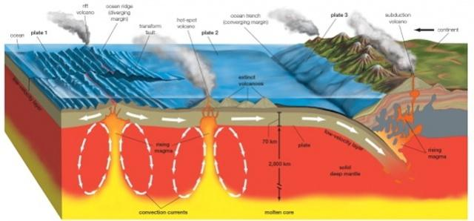
Plate Tectonics
Notes:
end of lesson 9 Prepare the students to watch the video. Pass out the paper for the students to work on while they watch the video to sum up the lesson that they learned. Afterwards, go over the answers with them.

Slide 10
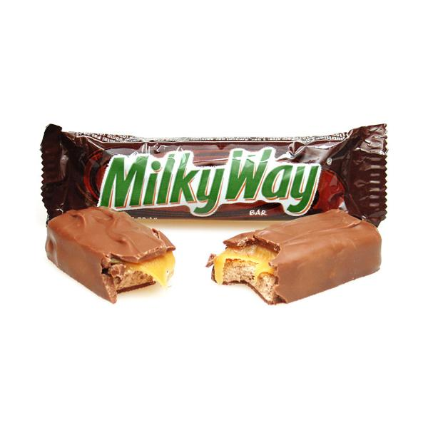
Plate Tectonics Lab (Candy)
Objective: Understand how plate tectonics on earth help form mountains and rifts.
Notes:
lesson 10. Create a demonstration for the students on what they will be doing. This way, the students won’t be confused on the day of the lab. Answer any questions that they have and clarify any steps. Go over the lab write up with them.

