Slide 1
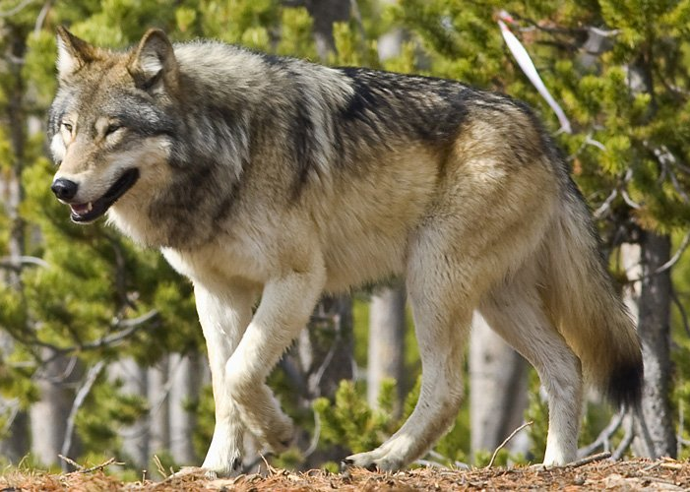
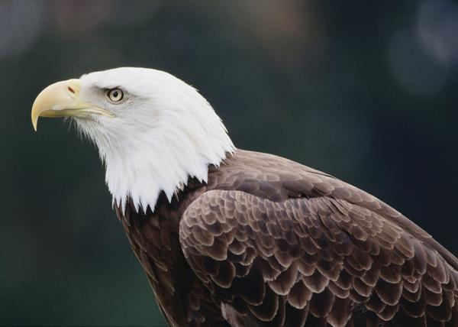
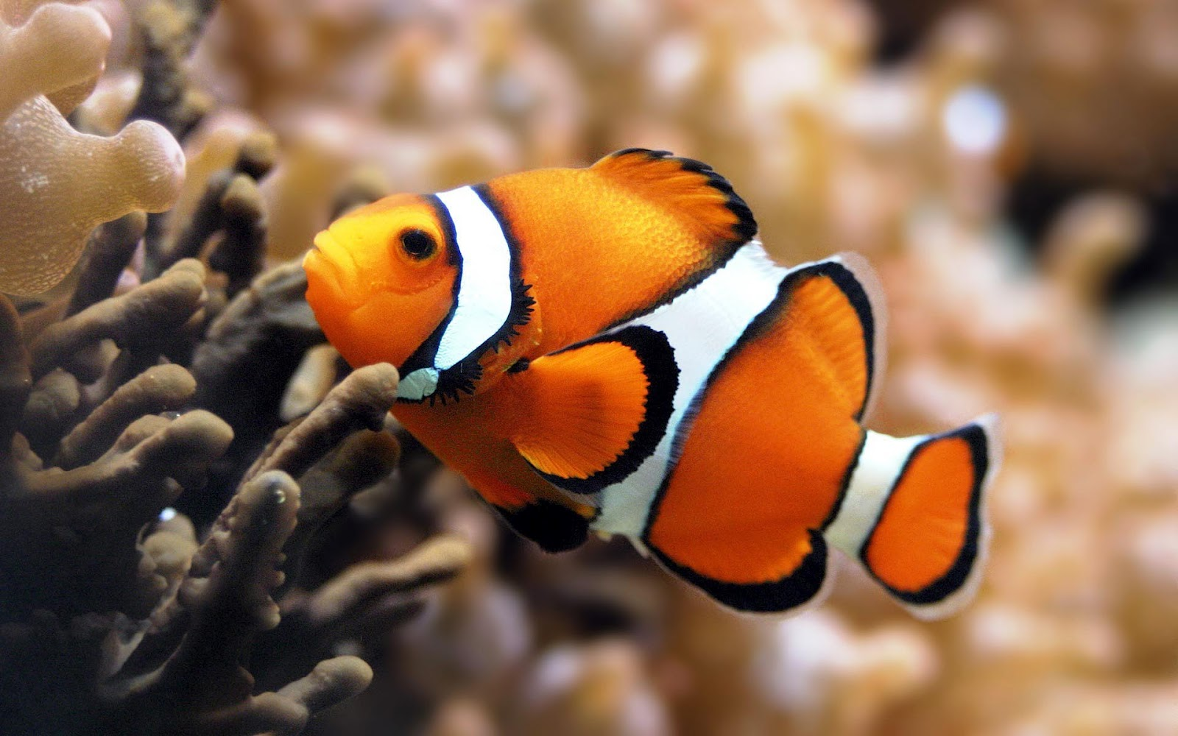
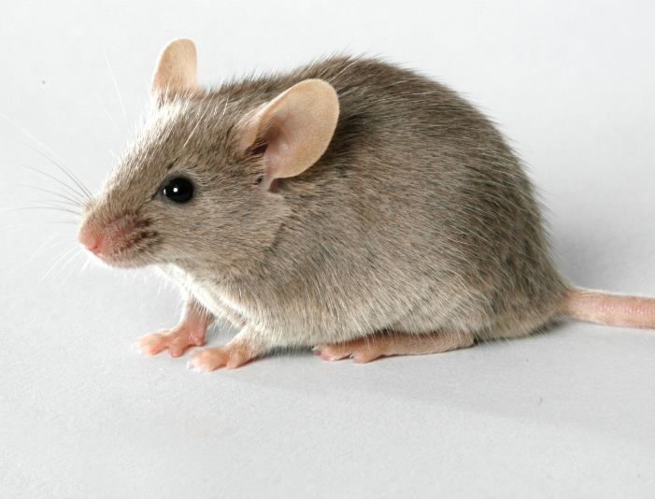
Competing For Food
Predator
an animal that feeds on another animal for food.
Prey
an animal that is being fed upon.
Competition - animals fighting over resources.
Notes:
In the wild, many animals compete for food.
competition - two or more species fighting over the same resource, usually ending up with one winner
could be for for food, for mating, etc.
predators - animal that feeds on another animals for food
usually the large, dangerous animals.
(ex. lion)
prey - animal caught for food
usually weaker and more defenseless.
(ex. lion’s prey: deer. other are mice, fish, bunnies, squirrels, etc.)

Slide 2
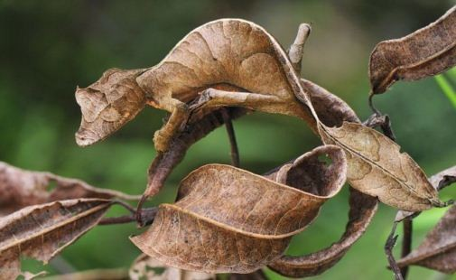
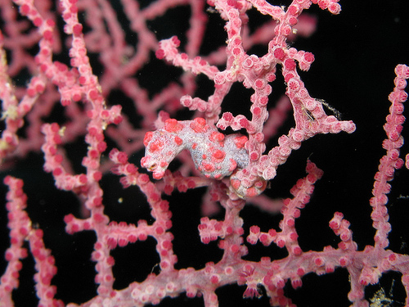
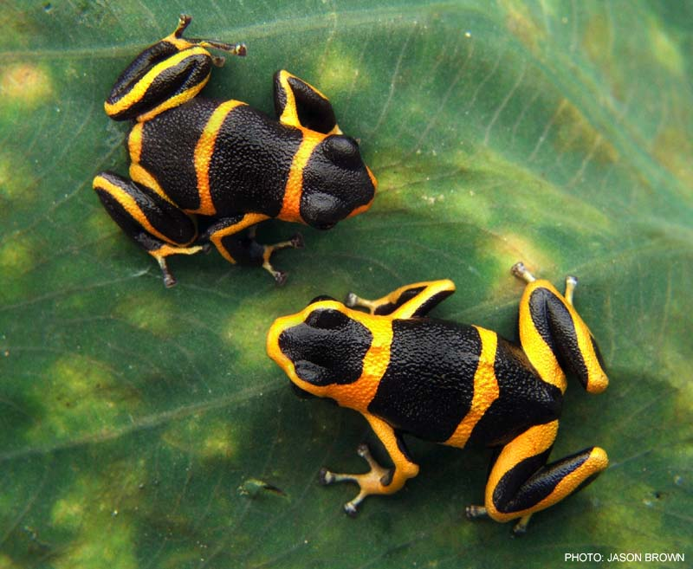
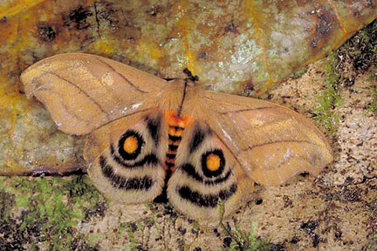
Adaptation Skills
Camouflage
when organisms blend in with their environment.
Mimicry
when one animal resembles another for protection.
Notes:
In order to compete and survive, over generations animals began developing adaptation skills.
camouflage - defense mechanism where organisms blend in with their environment.
(ex. iguana)
mimicry - resemblance of one organism to another or to natural objects among which it lives that secures it a selective advantage (as protection from predation)
this could be through the because one is poisonous, and the other is not. Or it could be through the look of a larger, scarier animal.
(ex. Monarch butterfly and Viceroy butterfly).

Slide 3
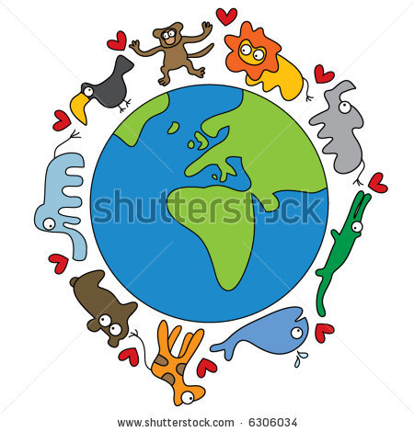
Loss of Species
Extinction - when a species
dies out around the world.
Extirpation - when a species
dies out in a certain area.
Notes:
With the environment constantly changing, there’s a possibility that extinction or extirpation might occur.
extinction - when a species of animals die out worldwide because they can’t adapt well to the changing environment
99% of the species that lived before are now extinct.
(ex. Wooly Mammoth, dodo bird)
extirpation - when a species of animals die out in a certain region/place because they can’t adapt well to the changing environment
“local extinction”
(ex. California condor.)

