Slide 1
The Ocean

Slide 2
Ocean: Large body of water
The ocean is salty water

Slide 3
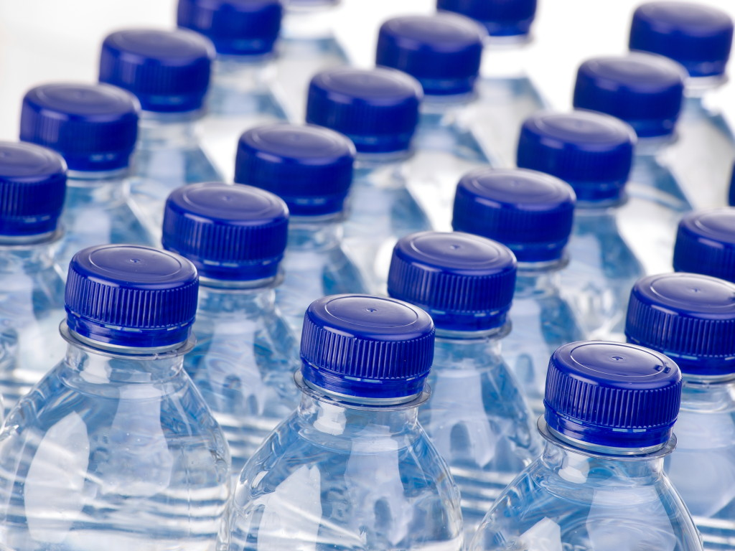
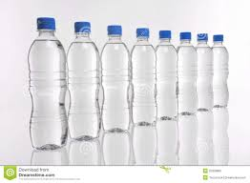
Freshwater
Freshwater: it is non-salty drinkable water
The ocean is not freshwater

Slide 4
Global Warming
We are causing our earth to go through Global Warming
Global Warming is where the earth gets more warmer
Ice from north and south pole are melting into the ocean causing oceans to have more water

Slide 5
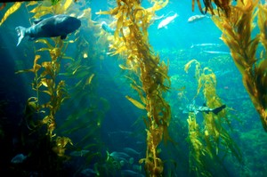
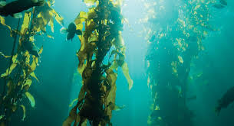
Kelp: large brown seaweed located in the ocean
It is eaten by many ocean animals

Slide 6
Algae: little living bacteria underwater that makes oxygen for us to breathe

Slide 7
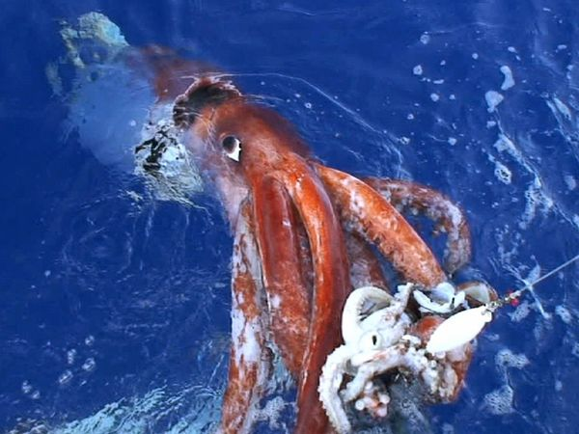
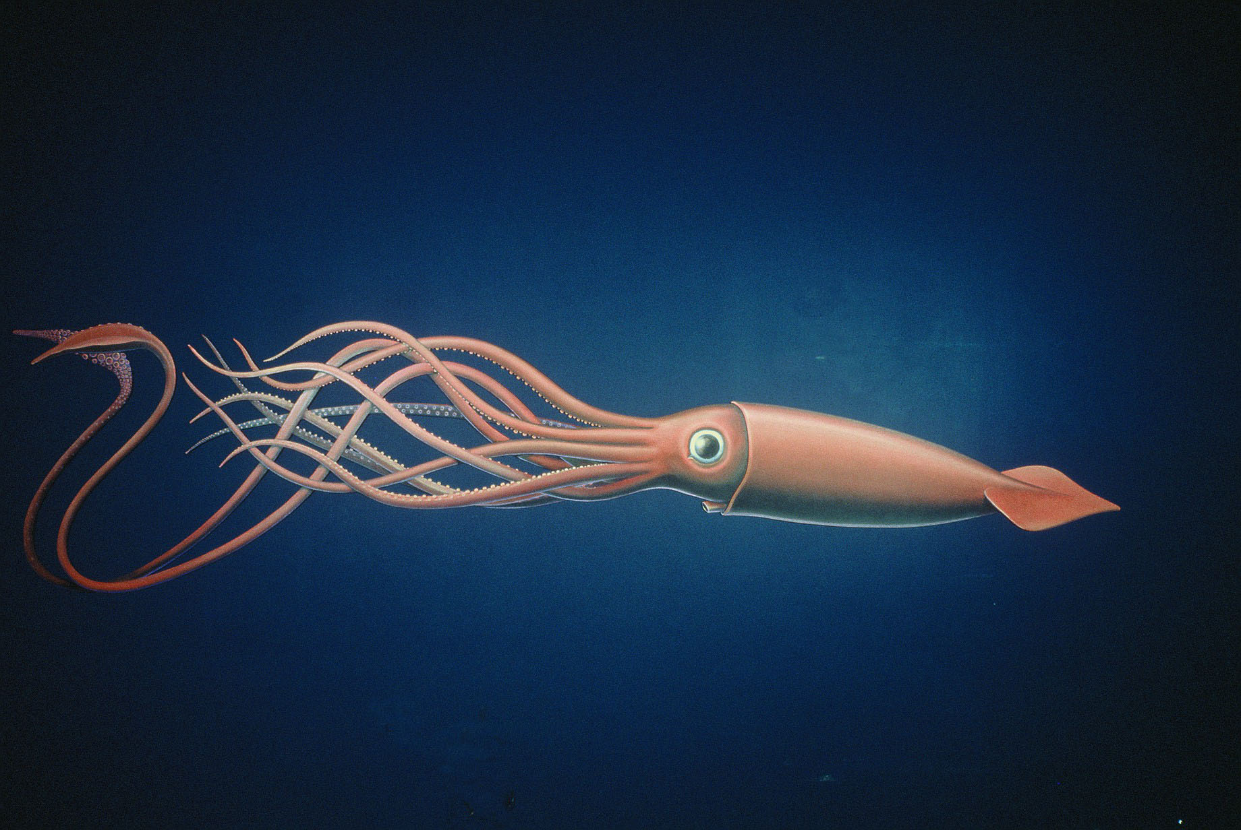
3 types of Consumers
Primary consumer: animals that eats plants only
Ex: Squid and sardines

Slide 8
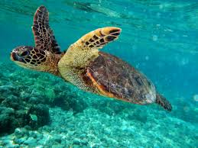
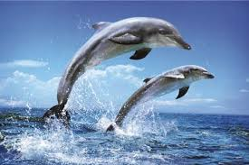
Secondary consumer: animal that eats primary consumers
Ex: Tuna, dolphins, and turtles

Slide 9
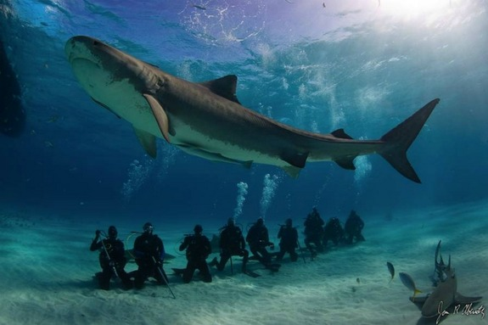
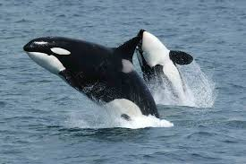
Tertiary consumers: Eat only animals
Ex: Sharks and whales

Slide 10
About the Ocean
Our ocean is slowly dying
We are causing too much pollution
Water Pollution: when water has ad stuff in it that can make one sick

Slide 11
What Can We Do?
We can help our oceans by not littering into the ocean
Littering: Throwing away our trash in undesired spots

