Slide 1
Air

Slide 2
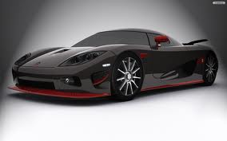
How do Humans dirty our air?
Automobiles: They are cars that release carbon dioxide into our air
Not only automobiles dirty our air, other things too

Slide 3
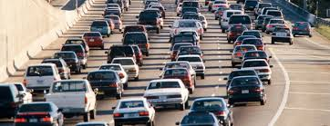
Carbon Dioxide
A type of gas that can hurt our environment
Our automobiles gives off a huge amount of Carbon dioxide

Slide 4
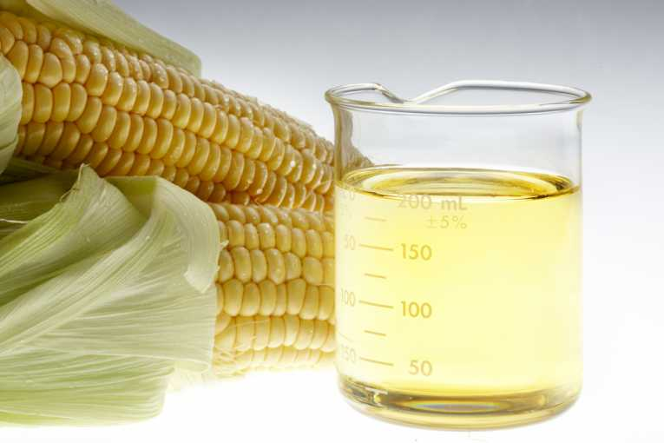
Humans made Biofuel
Another type of gas used for cars
It is better for the environment
Made naturally
Used corn to make biofuel

Slide 5
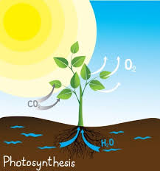
Photosynthesis
Photosynthesis takes in sunlight and uses that to grow
One reason to stop cutting down trees!
How would you feel if your home was cut down?

Slide 6
Cellular Respiration
Next step after photosynthesis
It takes in carbon dioxide ( dirty air ) and gives off oxygen

Slide 7
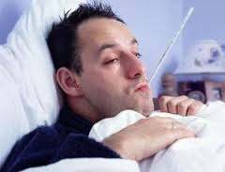
Sickness
Polluting our airs can make humans sick

Slide 8
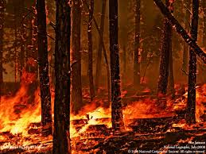
Forest Fires
Forest fires can hurt our atmosphere
It releases a huge amount of carbon dioxide

Slide 9
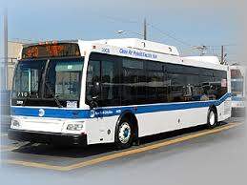
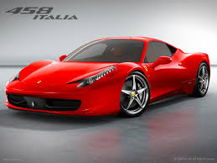
Cars or Buses?
Rather than driving, giving off so much carbon dioxide
Take the bus it will help the environment
Less Carbon dioxide released into the air

Slide 10
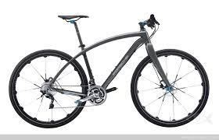
Walk or Bike
Walk or Bike to places like to go!
Uses no gas and you get exercise!!

