Slide 1
5TH GRADE SCIENCE CURRICULUM
Presented by Professors: Kingston Chen, Kevin Gu, Jasmine Li, Michelle Liu, Larissa Sun

Slide 2
Structure/Properties of Matter

Slide 3
Structure/Properties of Matter
Understanding our world and being able to use that knowledge to help us means describing things and understanding how they behave.
What are the ways and words we can use to describe “stuff?”
How does “stuff” behave? What does it do when we make changes to it?
Is the “stuff” one thing (pure) or more than one thing (mixture)?
Notes:
Fun way to engage students in the topic is to ask what “stuff” is. Explain that learning this will help students explain what these things are and how they behave.
Properties: Characteristics and behaviors we use to describe matter

Slide 4
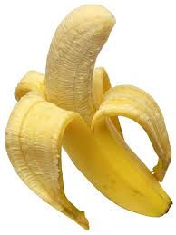
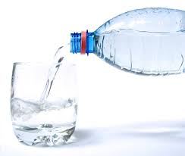
Matter – Anything that has mass and takes up space
Notes:
Tell students that matter is made of particles too small to be seen.
Point at various objects in the room and explain that they are all matter because they take up space.

Slide 5
Properties
Physical Properties – A characteristic of matter that can be observed by using any of your senses ex. color, hardness
Chemical Properties – A description of how one kind of matter behaves in the presence of another kind of matter. ex. vinegar + baking soda = CO₂
Notes:
Explain to students the difference between physical and chemical properties. Teachers are encouraged to choose an item nearby and ask students to make observations and measurements to identify materials based on their physical properties.

Slide 6
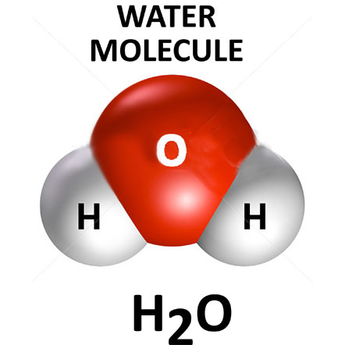
Molecule – The smallest particle of a substance (such as water) that can still be identified as that substance
Notes:
Tell students that atoms can make up molecules. An example is a water molecule. Explain that every water molecule is made up of 2 hydrogen atoms and 1 oxygen atom.

Slide 7
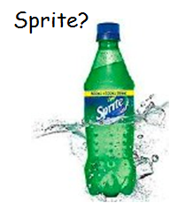
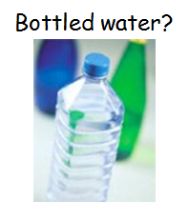
Matter can be pure or a mixture
Pure: single type of matter
Mixture: Mixed together but not chemically combined
Notes:
Teach the differences between a pure solution and a mixture. The bottled water is a pure solution, while sprite is a mixture because it also contains sugar, besides water. Ask students for another example of a pure substance and a mixture.
Example:
ocean - mixture (has salts, fish, seaweed)
salt - pure (made of sodium chloride)

Slide 8
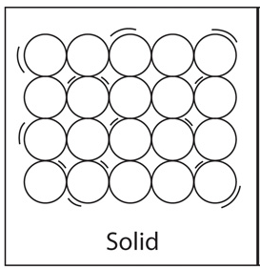
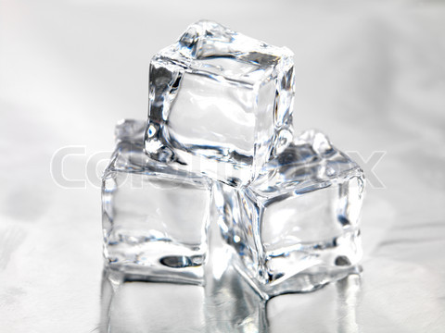
Solid
Definite Shape: Yes | Definite Volume: Yes
Notes:
Tell students that one state of matter is solid. Ask students to name an example of a solid.
Ask students how a solid can change into a liquid. It changes by melting.

Slide 9
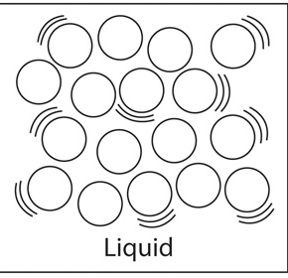
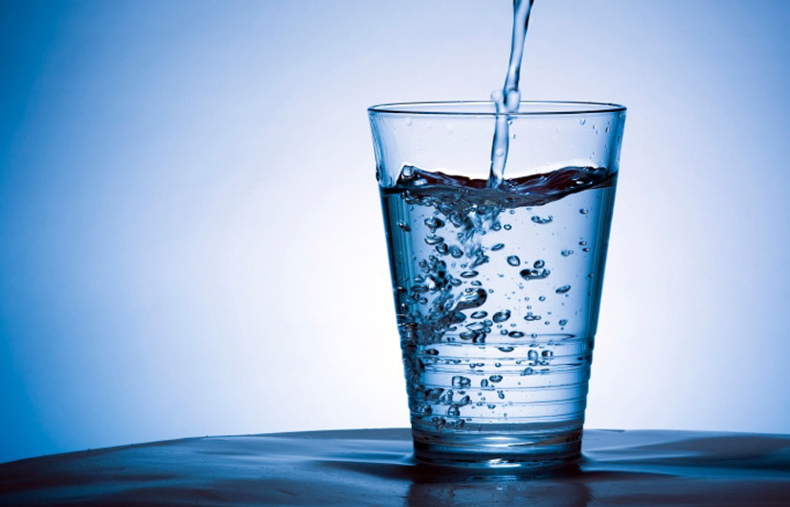
Liquid
Definite Shape: No | Definite Volume: Yes
Notes:
Tell students that a second state of matter is liquid. Ask students what another example of a liquid is.
Ask students how a liquid changes to a solid and gas. It changes to a solid by freezing, while it changes to a gas through evaporation.

Slide 10
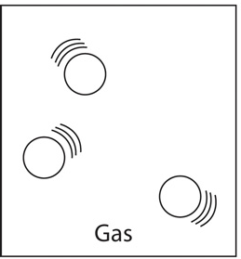
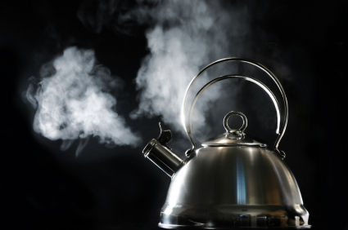
Gas
Definite Shape: No | Definite Volume | No
Notes:
Tell students that a third state of matter is gas. Ask students to name an example of a gas.
Ask students how a gas can change to liquid. This process is called condensation.

Slide 11
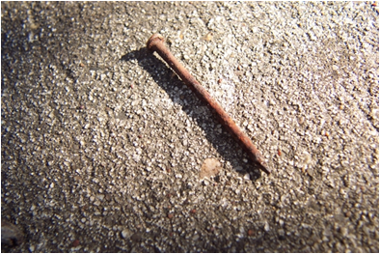
Changes
Physical Change- form or appearance of matter changes but not its composition (shape, change in state)
Chemical Change – composition of a substance changes (rust, fireworks)
Notes:
Explain the difference between physical change and chemical change, with examples.
Interactive idea: If there is scratch paper available, ask students to scrunch up paper to demonstrate a physical change. The paper has simply changed shape, so it is a physical change.

Slide 12
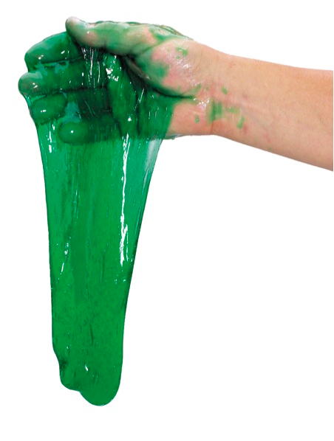
Slime/Putty Pre-Lab
- does the mixing of these substances result in new substances?
- make observations/identify materials
- will have properties of liquid and solid
Notes:
Ask students whether it is a physical or chemical change.
Ask students to make predictions of the physical appearance of the slime.
Explain to students how it can take the shape of containers, like liquids, yet you can hold it in your hand, like a solid. Tell students that they will witness this firsthand tomorrow.

