Slide 1
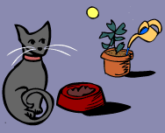
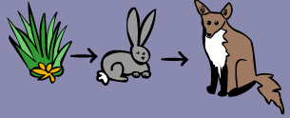
The Food Chain
What is the Food chain?
A food chain shows how each living thing gets food, and how nutrients and energy are passed from animal to animal
A simple food chain could start with grass, which is eaten by rabbits. Then the rabbits are eaten by foxes.
Did you know?
Food chains begin with plant-life, and end with animal-life.
Now draw your own food chain!
Notes:
http://www.sheppardsoftware.com/content/animals/kidscorner/foodchain/foodchain.htm

