Slide 1
Week 4
Characteristics of Waves

Slide 2
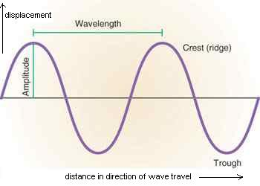
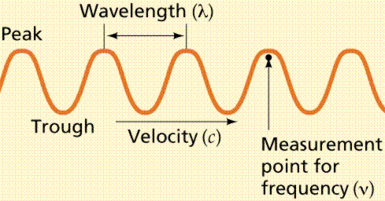
How are waves characterized?
Waves are characterized by wavelength, amplitude, speed, and frequency
The highest point of a wave is called the Crest or Peak
The lowest point of a wave is called the trough
Notes:
Describe transmission of light, transparency, translucence, opaqueness, and and luminosity. Use an experiment with clean water versus dirty water and have students describe their qualities.

Slide 3
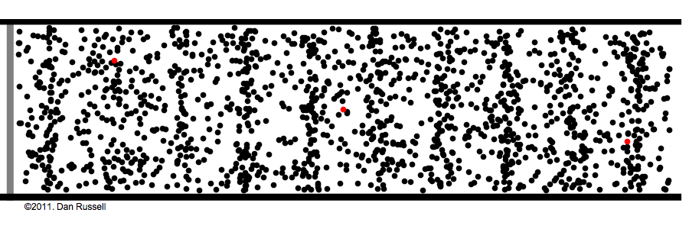
Longitudinal Waves
Waves where the disturbances move in the same direction as the wave
Waves move then go back to where they started
Notes:
Tell the kids to focus on only one part of the molecule and ask them if they are moving from one side of the picture to the other.
They can also give a further example of longitudinal waves. They can say that there is a line of kids. The kid at the back pushes the kid in front of him which leads to the pushed kid to bump into the kid in front of him. As each kid bump into the one in front of them, they move back and stop at their original spot. Thus, they were a living example of longitudinal waves.

Slide 4
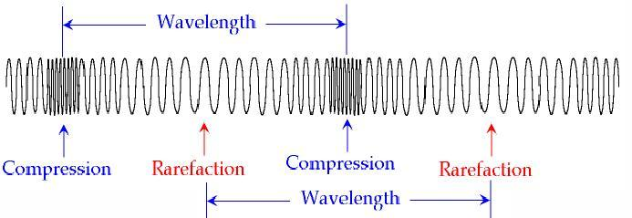
Longitudinal Waves Cont’d
Longitudinal waves create compressions and rarefactions
Compressions:region of area in longitudinal wave where the particles are the closest
Rarefactions:region of longitudinal wave where the particles are the furthest apart
Notes:
You can ask the kids if they can tell what the differences between compression and rarefaction are by just looking at the picture.

Slide 5
An Example of a Longitudinal Wave
-Sound
-As sound pierces the air, it travels in waves back and forth through the air
-the speaker shoves air molecules into the air and it creates waves in the air

Slide 6
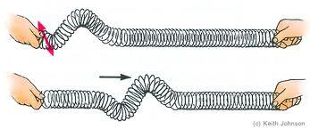
Transverse Wave
Particles of the medium (example: water) move in a direction up and down to the direction the wave moves.
Notes:
If the kids are unable to understand the definition of Transverse wave, you can easily bring in a slingy to help explain. Have two kids hold each end horizontly and tell them to shake it up and down. The slinky will then vibrate perpendicularly and show transverse waves.

Slide 7
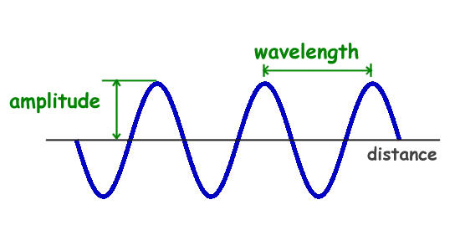
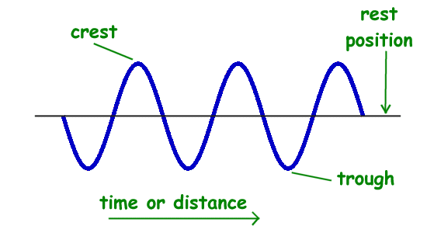
Amplitude & Wavelength
Amplitude: largest shift in particle of the medium from its equilibrium
Wavelength: distance from the crest to the next crest or trough to trough
Notes:
The teacher can pose this question to their students: What are crests? What are troughs? Where is equilbrium? They can give a hint suggesting that the picture can help them.

Slide 8
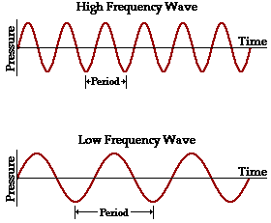
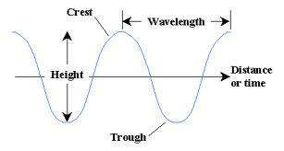
Frequency & Period
Period: seconds per cycle
Frequency: cycles per second
Wave Speed: speed at which a wave travel and is equal to wavelength x frequency

Slide 9
Reflection of Waves
When a wave encounters a different medium, some of the wave may come back and some may go through the new medium
Examples: Light waves bounce off objects; Water is absorbed by a sponge
Notes:
A perfect demonstration would be to bring a flashlight and a mirror and shine the flashlight at the mirror using different angles.

