Slide 1
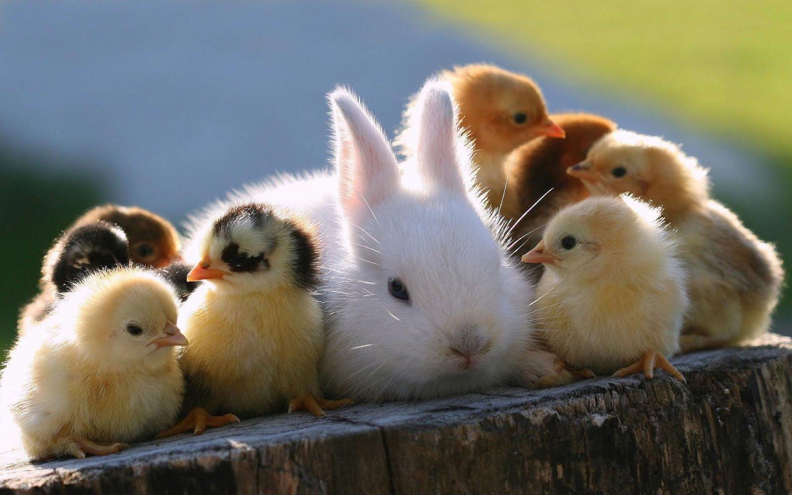
Animals, Plants, and Their Environment
Notes:
Questions to ask and elaborate on: Do they have any pets? If so, what do the pets need to survive?

Slide 2
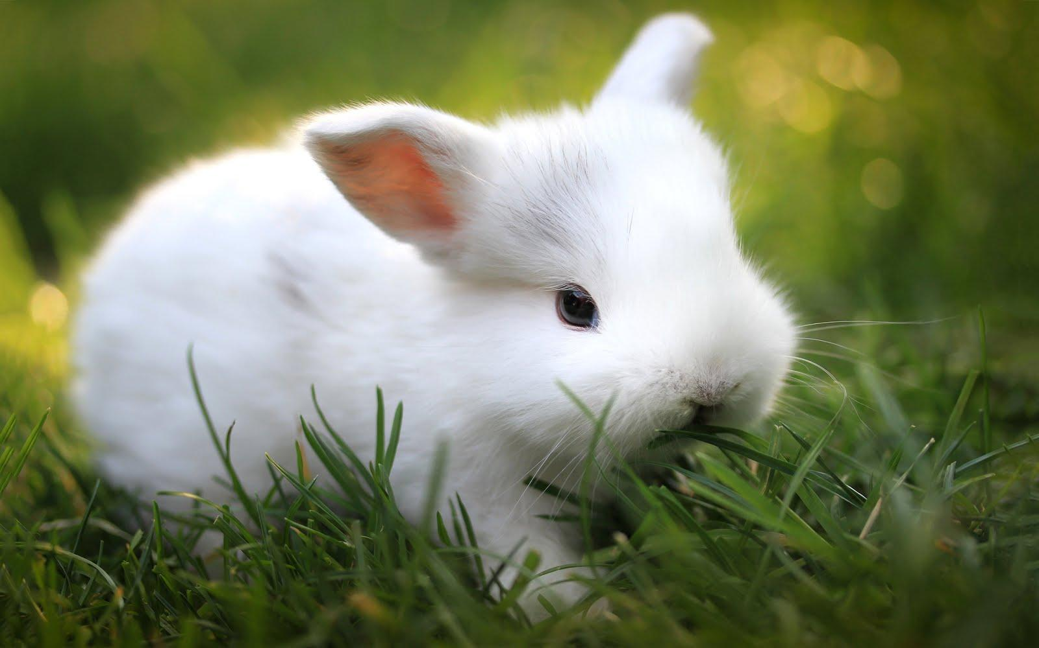
Herbivore
This bunny is a herbivore because it gets most of its energy from eating plants and fruits.
Notes:
Ask for examples of a herbivore.

Slide 3
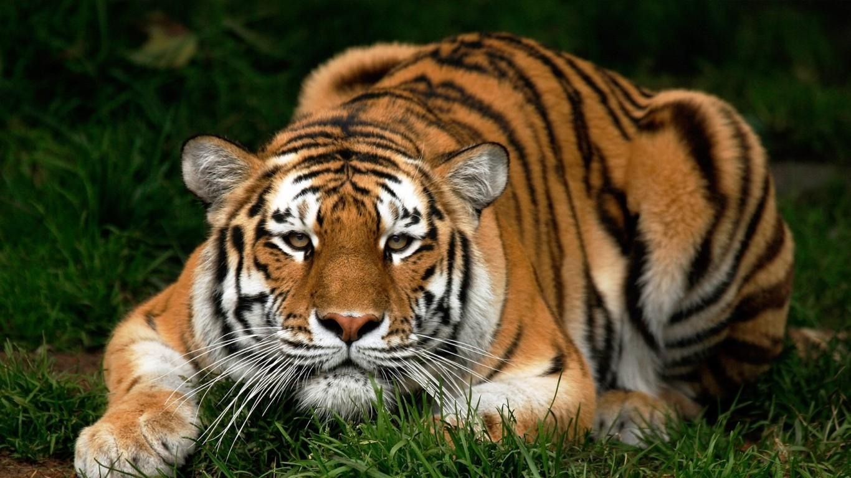
Carnivore
This tiger is a carnivore because he gets most of his energy from eating meat
Notes:
Ask for examples of a carnivore

Slide 4
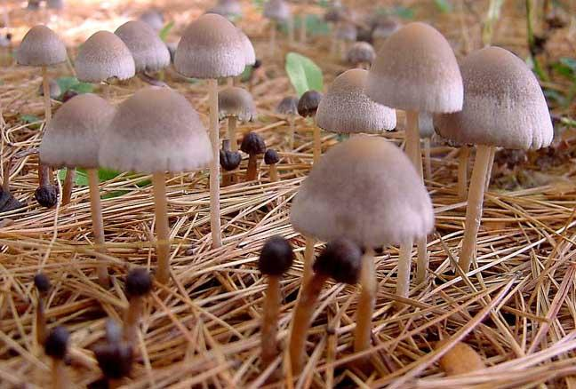
Decomposer
Mushrooms are decomposers because they break down dead plants and animals.
Notes:
Ask for examples of another decomposer

Slide 5
Decomposer
Mushrooms are decomposers because they break down dead plants and animals.
Notes:
Ask for examples of another decomposer

Slide 6
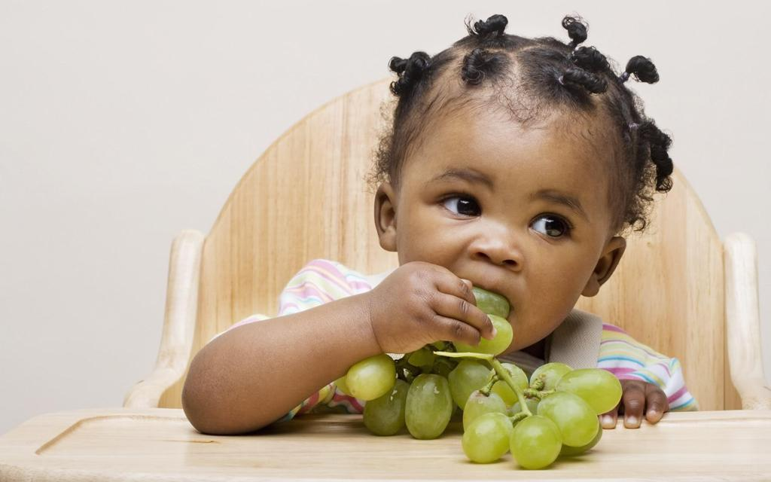
Omnivore
We are omnivores because we eat both meat and vegetables.
Notes:
What did you eat for breakfast today? What is your favorite type of food?

Slide 7
Producers
Plants are producers because they can use sunlight to make food.
Notes:
Does anyone have a tree, a garden, or grass at home? What do you think makes them grow?

Slide 8
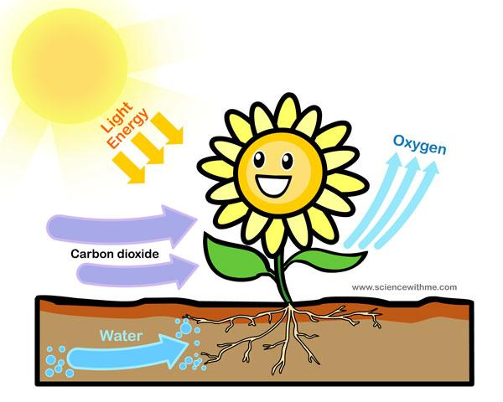
HOW PLANTS MAKE FOOD
Notes:
Plants take in energy from the sun and a gas called carbon dioxide to make the oxygen that we breathe. Therefore we need plants because they give us food and oxygen.

Slide 9
Primary Consumers
Fish are primary consumers because they eat producers like plants.
Notes:
Can you name another primary consumer?

Slide 10
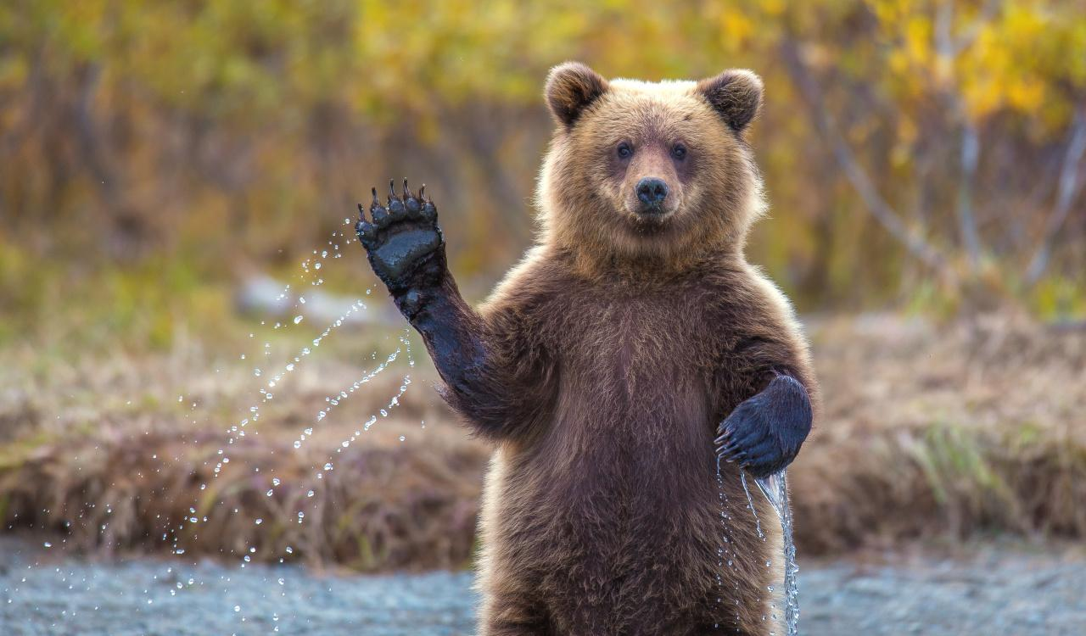
Secondary Consumer
Bears are a secondary consumer because they eat primary consumers like fish.
Notes:
Have them name another secondary consumer.

Slide 11
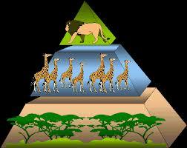
Secondary Consumers
Primary Consumers
Producers
Notes:
The plants take up a larger area then there are less primary consumers and then even less secondary consumers which form a pyramid.

